Slide 1
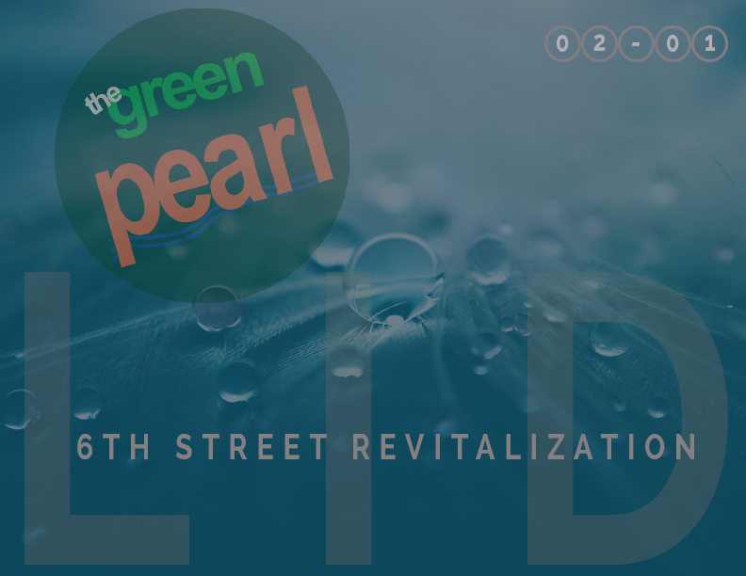

Slide 2
If you plan cities for cars and traffic, you get cars and traffic. If you plan for people and places, you get people and places.
– Fred Kent
TABLE OF CONTENTS
3
Project Challenge
8
Project Vision
12
Low Impact Strategy
27
Next Steps
PEARL DISTRICT
Notes:
“Water is the driving force in nature.” ― Leonardo da Vinci

Slide 3
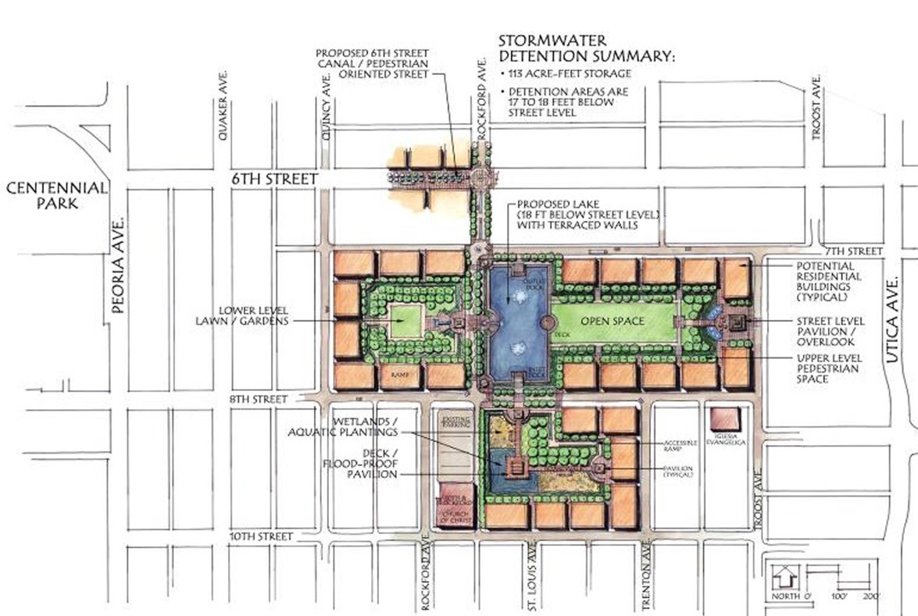
PROJECT CHALLENGE
Summary of Design Concept
The Program
Pearl Plaza is part of the 6th Street Infill Plan which was adopted in 2006. The Pearl District Association has been actively involved in planning for the revitalization of their neighborhood. The neighborhood has experienced significant flooding problems and is in need of a revitalization effort to help stimulate reinvestment and growth. The proposed flood control improvements in the 6th Street Infill Plan include a two cell 10’x10’ reinforced concrete box below grade for stormwater conveyance, an open channel at street level as public amenity and water feature, and reconstruction of 6th Street between Peoria and Rockford Avenue and Rockford Avenue between 6th Street and 7th Street.
3
Proposed Plan from the Elm Creek/6th Street Drainage, Detention, and Conveyance Plan, March 2010
PEARL DISTRICT

Slide 4
PROJECT CHALLENGE
Summary of Design Concept
Our Objectives
Develop a new standard LID road section that can serve as a model for future Tulsa streets.
Create a pedestrian plaza that emphasizes people over vehicular traffic.
Reduce development costs from those included in currently proposed design.
Reduce stormwater peak runoff discharge rates.
Minimize and disconnect impervious surfaces, lengthen time of concentration, and promote
bio-filtration of runoff to improve the quality of stormwater leaving the site.
Eliminate storm drain inlets and piping along 6th Street and minimize drainage infrastructure.
Minimize the need for potable water for irrigation.
Continue Pearl District branding to create a pedestrian destination.
Increase marketability of development in the Pearl District.
4
PEARL DISTRICT

Slide 5
EXISTING CONDITIONS
Location Map
5
PEARL DISTRICT

Slide 6
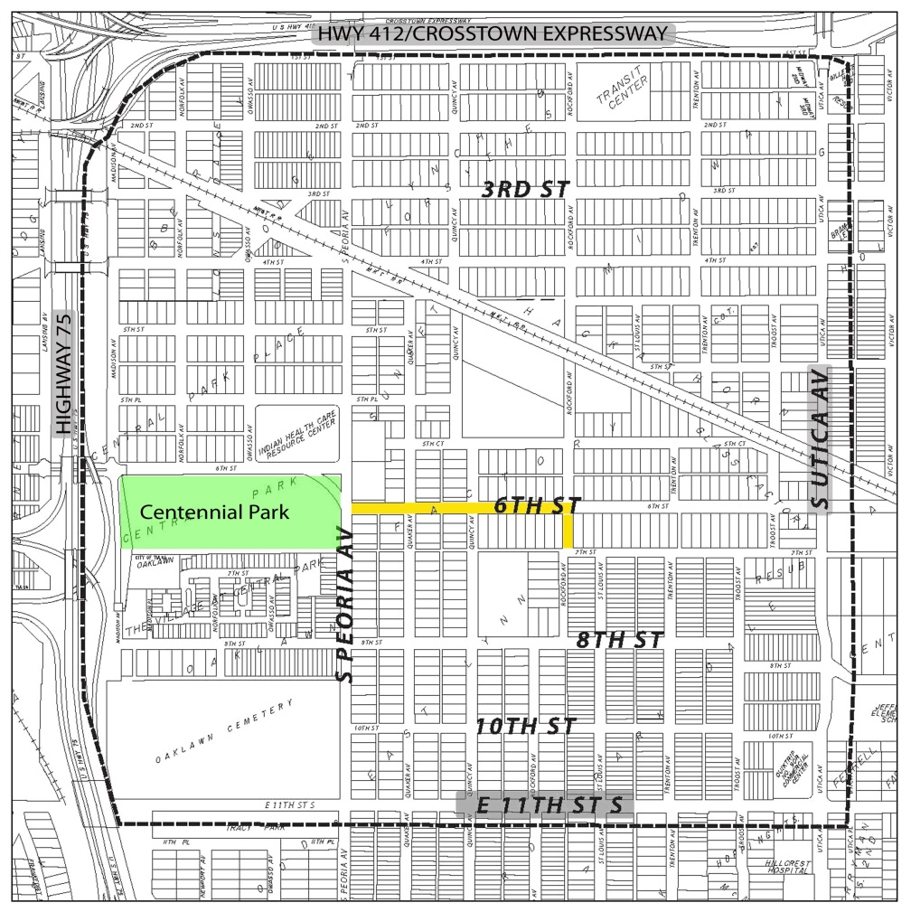
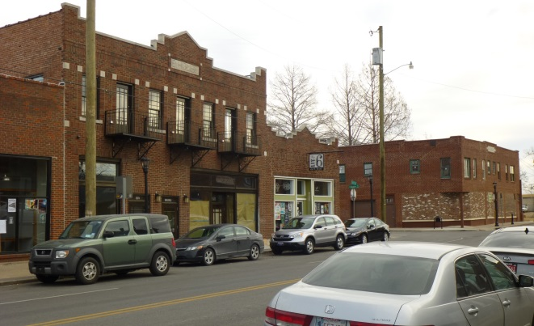
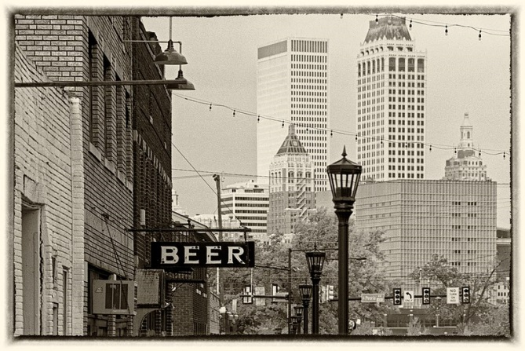
EXISTING CONDITIONS
Pearl District Site
The project area is located within the historic Pearl District, extending along 6th Street between Peoria Avenue and Rockford Avenue (highlighted in yellow).
6
A hundred years after we are gone and forgotten, those who never heard of us will be living with the results of our actions. – Oliver Wendell Holmes
PEARL DISTRICT

Slide 7
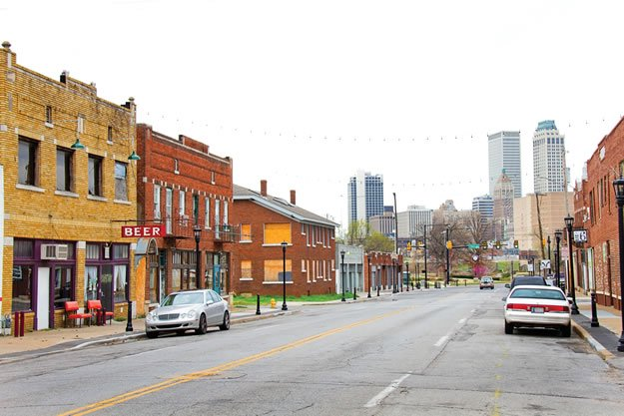
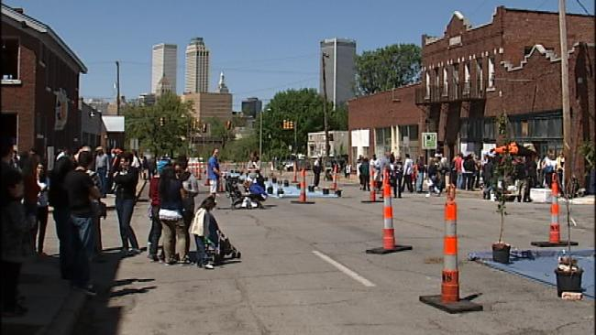
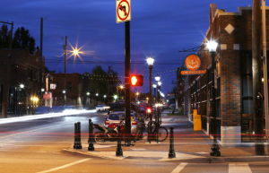
EXISTING CONDITIONS
The mission statement for the Pearl District Association is to “reinvent the art of city life” with an emphasis on turning the neighborhood into a “world class model of sustainability, community, economic reinvigoration and pedestrian friendly lifestyle”. The Pearl District is bounded by Interstate 244, Utica Avenue, 11th Street and US Highway 75/Inner Dispersal Loop. Several decades ago, 6th Street was a thriving corridor, but over the years, like many areas, has seen decline in business and home ownership.
The area has may excellent opportunities for redevelopment including the close proximity to downtown, recent investment and revitalization at The Village at Centennial Park, convenient access to public transportation, connectivity to Centennial Park, and the ability to provide a link between Tulsa University and downtown Tulsa. A historic district exists along 6th Street between Peoria and Quaker includes several classically designed brick structures that have great potential for renovation or reuse. The proposed land use for the project site is Mixed Use Infill based on The 6th Street Infill Plan that was adopted in 2006.
7
PEARL DISTRICT

Slide 8
The desire for community is a constant of human nature.
– Stephen Price
PROJECT VISION
Design Summary
Concerns with 2010 Elm Creek Plan
The current plan identified several preferences by the neighborhood including:
A desire for pedestrian-oriented development
A lack of enthusiasm for suburban, car-oriented development
A preference for quality of design over density and building type
Acceptance of mixed-use development
Urban water features/ lakes / canals
Walkable urban neighborhood
The proposed design incorporates the desires of the community and would create a pedestrian oriented space. Two main concerns with the 2010 Elm Creek design that we resolve with our proposed design are the circulation conflicts between a water feature in the center of the street with traffic on either side, and the idea that the proposed design includes all impervious surface with no regard to stormwater run-off. Although the character sketch of the site invokes a pedestrian friendly feeling, the section and perspective of the site show that accessing the canal would require crossing traffic without much space for enjoyment near the edge of the canal. Currently, the site experiences flooding issues, which has resulted in plans for major stormwater infrastructure in the future. The proposed design manages the flooding issues with traditional stormwater infrastructure techniques. While effective at managing water, the design does not assist in the quality or reduced quantity of stormwater run-off in the area.
8
PEARL DISTRICT

Slide 9
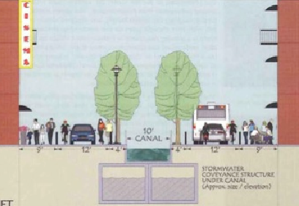
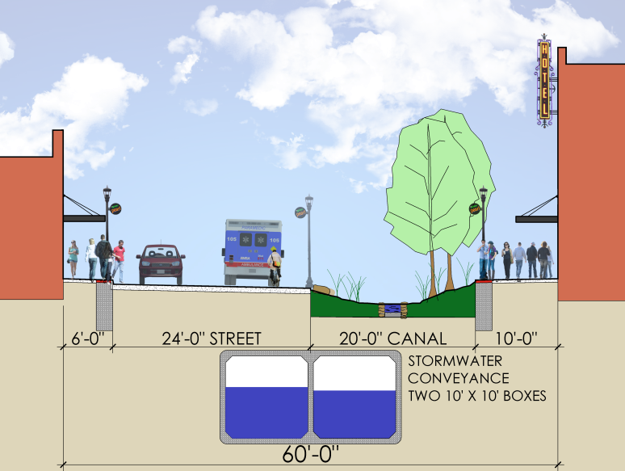
ELM CREEK PLAN versus LOW IMPACT DEVELOPMENT
Elm Creek Plan - Street Section
The canal is separated from much of the street life due to traffic.
The canal would use significant water resources or large pumps to achieve flow.
Green spaces along the sides of the canal are too narrow to promote good growth.
LID - Street Section
The canal is well integrated along the sidewalks and alternates on each side of the block.
The water channel itself is narrow with stone walls similar to Centennial Park and evokes images of a natural creek.
Water is supplied from the storm water system with minimal pumping required.
Green spaces are wide to support growth and function as infiltration and storage areas during storm events.
9
PEARL DISTRICT

Slide 10
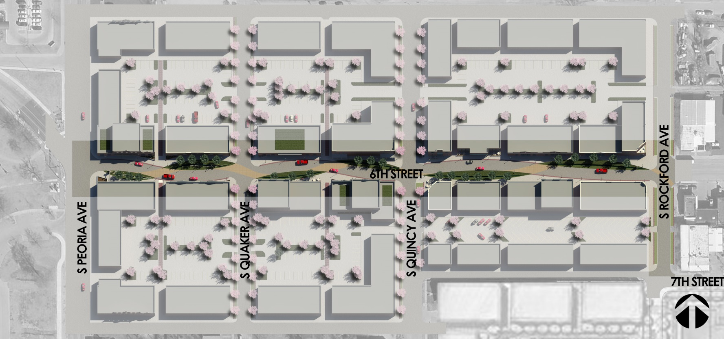
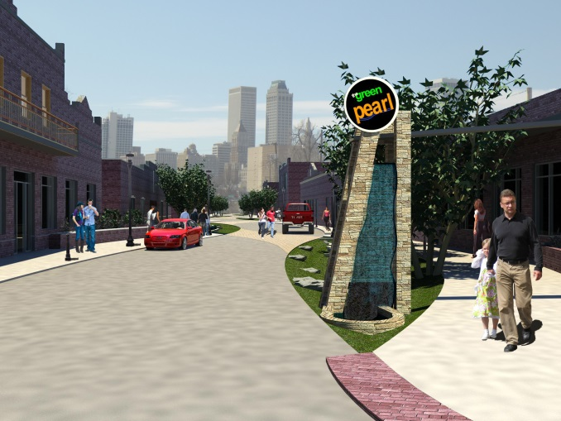
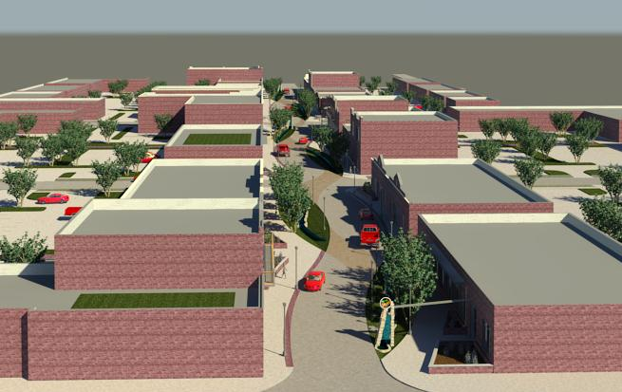
1 Centennial Park
Connection
2 Neighborhood
Gateway
3 Redeveloped 6th
Street
4 Canal (full length
of 6th Street from
Peoria to Rockford)
5 Parking lots at the
rear of buildings
OVERALL PLAN
5
5
1
2
3
2
4
2
5
5
10
PEARL DISTRICT
Neighborhood Gateway
6th Street Revitalization

Slide 11
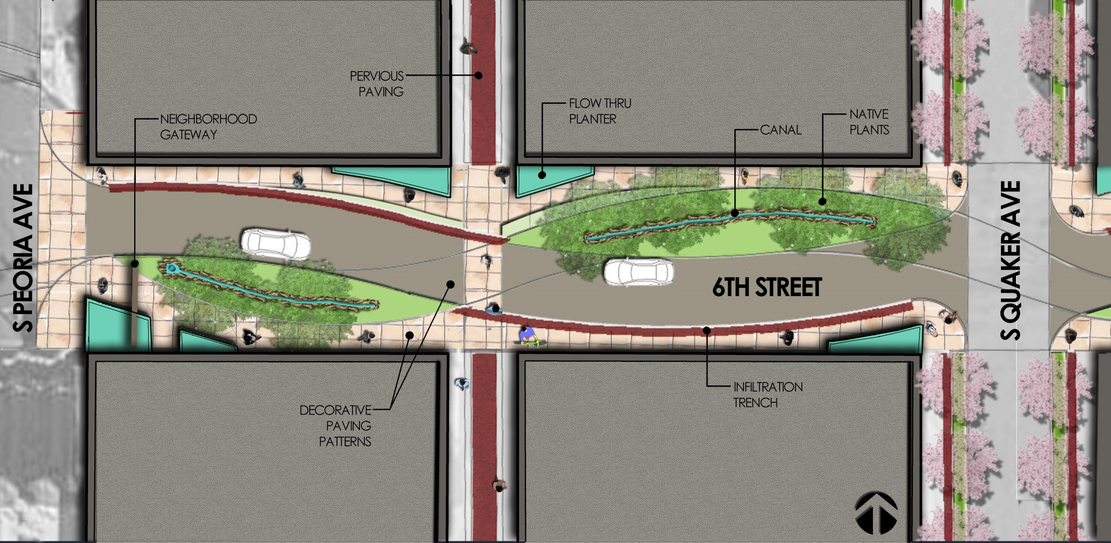
OVERALL PLAN
6th Street Revitalization
The proposed LID design along 6th Street provides a vibrant, pedestrian space.
It includes many features to enhance the quality of life and establish a low impact development.
11
PEARL DISTRICT

Slide 12
LOW IMPACT DEVELOPMENT STRATEGY
Simple changes make a big difference.
By incorporating some simple, proven details in our plan for 6th Street, big gains can be realized, including:
Reduced infrastructure requirements and cost.
Reduced local flooding.
Improved water quality.
Increased access to nature.
Improved quality of life.
Reduce infrastructure and maintenance costs.
Our proposed project includes bioswales, infiltration trenches, bioretention medians, pervious paving, and flow through planters as part of the LID design.
12
PEARL DISTRICT

Slide 13
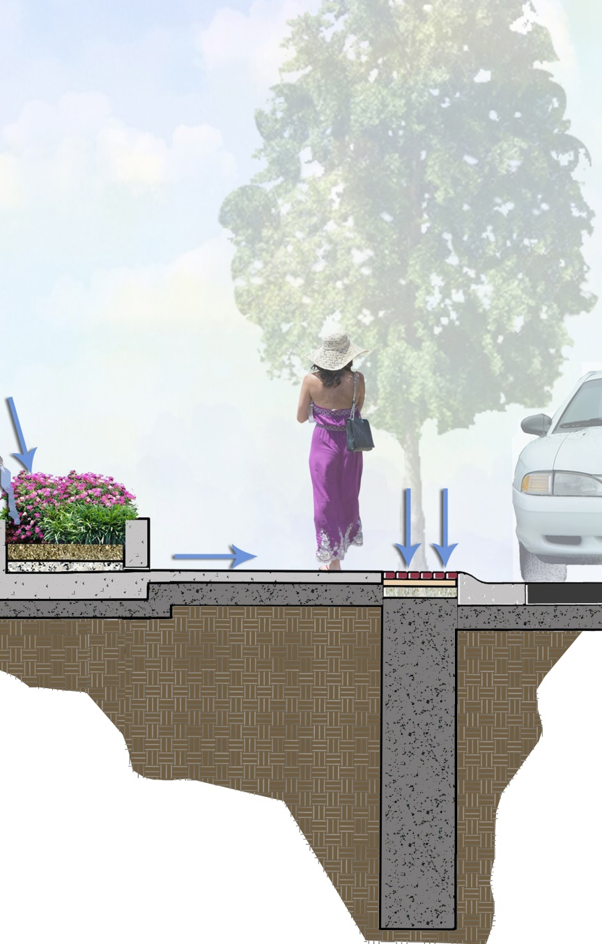
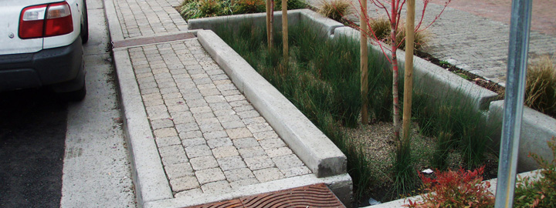
We never know the worth of water till the well is dry. ” ― Thomas Fuller
LOW IMPACT DEVELOPMENT
Infiltration Trench
Infiltration trenches will be located between the sidewalk and street. These trenches work in conjunction with other LID elements to reduce water runoff.
The trenches also improve water quality by receiving the “first flush” and the associated contaminates.
Pavers at the top of the trench are incorporated into the paving pattern to add color, texture, and interest along the street.
13
PEARL DISTRICT

Slide 14
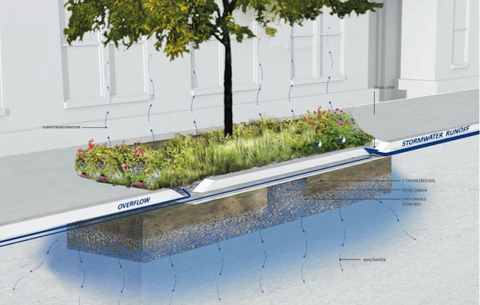
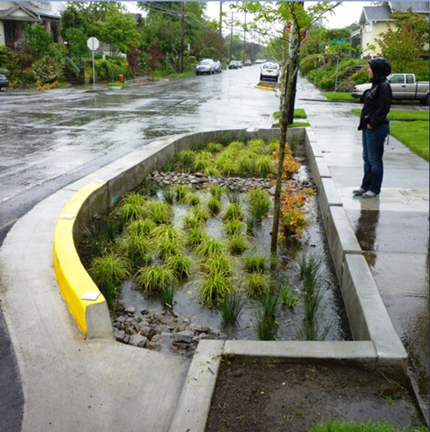
LOW IMPACT DEVELOPMENT
Bioretention Median
Bioretention Medians are an effective method to collect and filter runoff.
We propose that these medians be located along Quaker Avenue, Quincy Avenue, and Rockford Avenue to intercept stormwater runoff before it reaches 6th Street.
Using native plants and decorative pavers, these medians will:
Reduce total runoff volume.
Reduce peak discharge rates.
Improve site landscaping.
Improve water quality.
14
PEARL DISTRICT

Slide 15
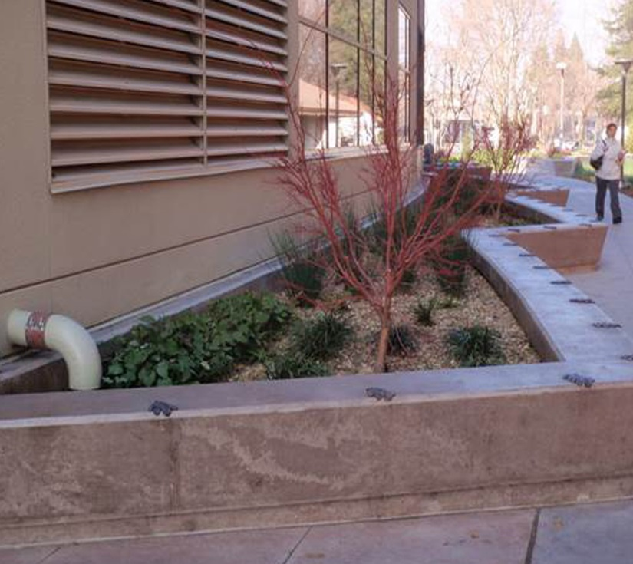
LOW IMPACT DEVELOPMENT
Flow Thru Planters
Similar to the bioretention medians, flow thru planters capture rain water from roof downspouts. Water is collected within the planter and allowed to infiltrate into the soil below. During heavy rain events, overflow water is discharged directly into the storm sewer system. We propose that these planters be utilized along 6th Street and at all downspout locations.
Using native plants, these planters are both LID and functional:
Reduce total runoff volume.
Reduce peak discharge rates.
Improve site landscaping.
Improve water quality.
Provide seat walls along the street.
15
PEARL DISTRICT

Slide 16
LOW IMPACT DEVELOPMENT
Canal Design
The canal functions as both an inviting water feature and part of the LID storm water system. Typically, water in the canal is contained in low stone walls that continue the aesthetics of Centennial Park.
During heavy storm events, the canal can accommodate significant runoff from the street, sidewalks, and buildings. Water is held in the canal for a period and will slowly re-enter the storm water box and the Centennial Park pond.
16
PEARL DISTRICT

Slide 17
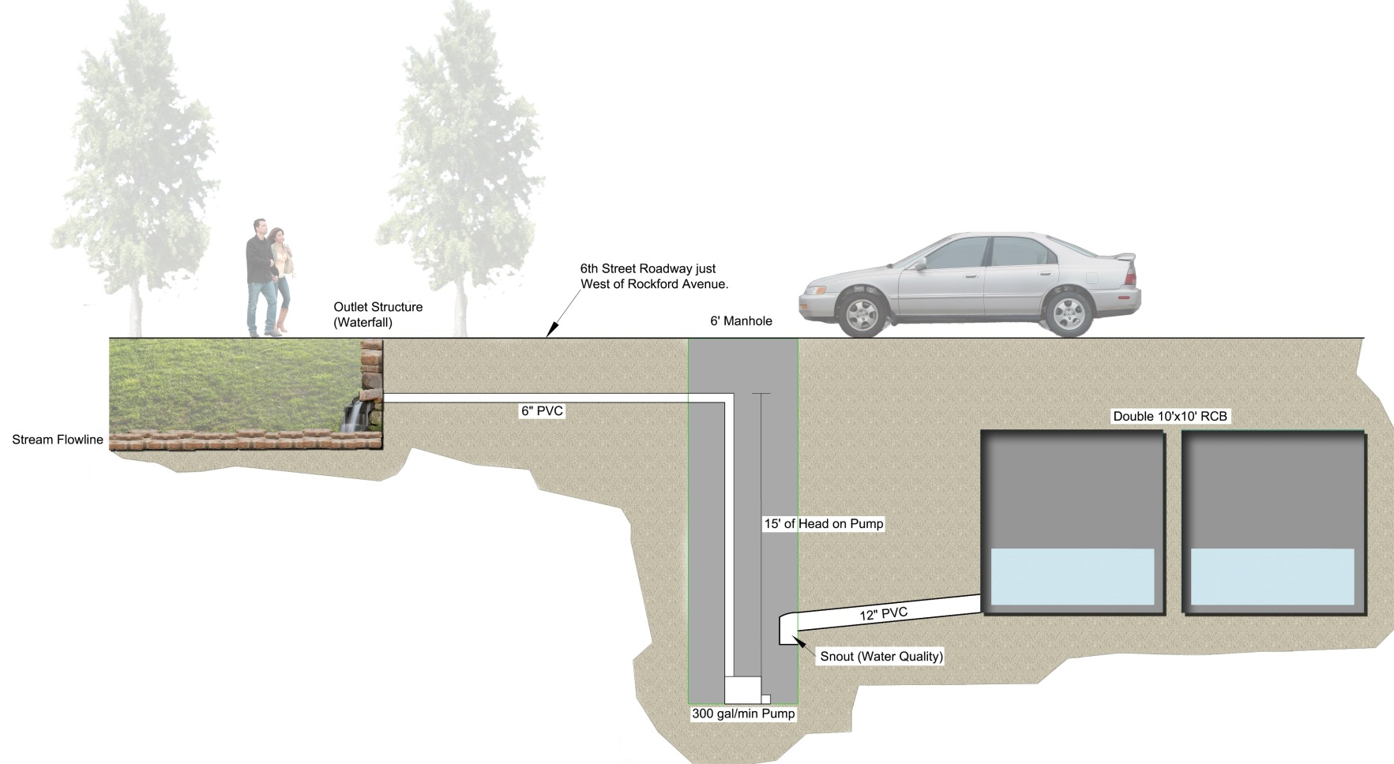
LOW IMPACT DEVELOPMENT
Canal Hydrology
The canal will utilize water from the reinforced concrete box. Water will gravity flow from the storm water system into an adjacent cistern. Water is then pumped up and discharged into the canal at the east end. At the west end of the canal, water will then drain back into the storm water system. This cistern system eliminates the need for domestic water, reduces the size of the pump, and does not require water treatment.
17
PEARL DISTRICT

Slide 18
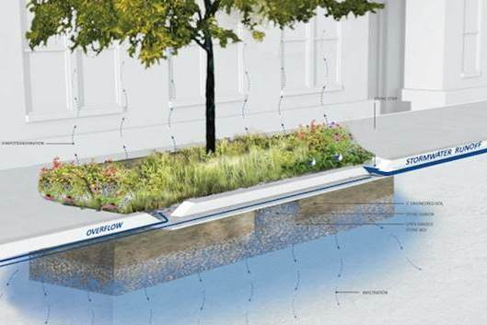

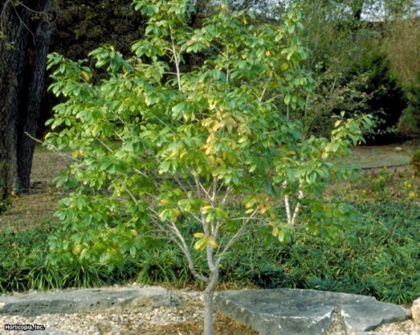
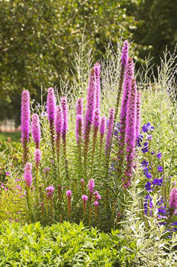
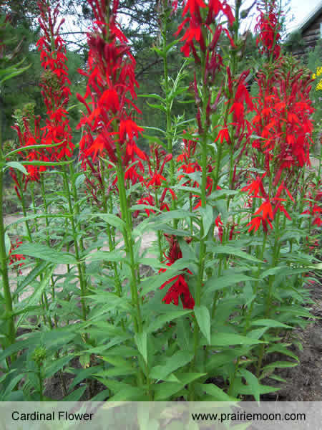
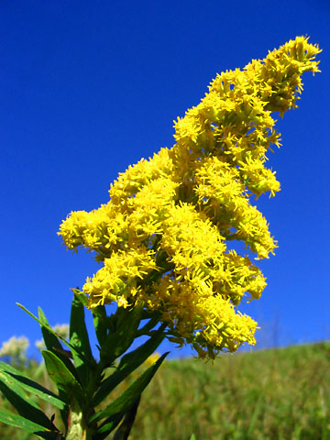
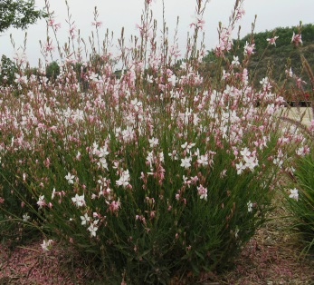
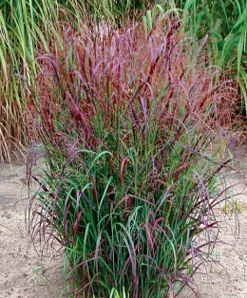
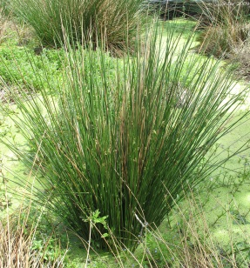
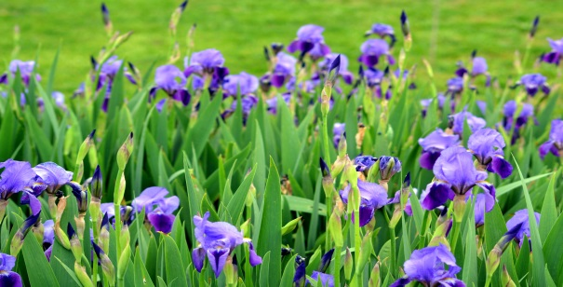
He plants trees to benefit another generation.
- Caecilius Statius
LOW IMPACT DEVELOPMENT
Bioretention Median Plant Species
Tolerant of varied moisture conditions (wet and dry).
Tolerant of varied soil types and growing conditions.
Available in Oklahoma plant nurseries.
Low maintenance requirements.
Not invasive weeds.
Do not have aggressive/invasive root systems.
Exhibit an attractive appearance.
Plant Species:
Juncus
St Johns Wort
Dwarf Inkberry
Dwarf Virginia Sweetspire
Blackeyed Susans
Gray’s Sedge
Red Switchgrass
Blazing Star
Bushy Bluestem
Butterfly Weed
Cardinal Flower
Carolina Buckthorn
Carolina Snailseed
False Indigo
Gaura
Goldenrod
Indian Blanket
Indian Paintbrush
Joe-Pye Weed
Cockspur Hawthorn
Link to detailed landscape recommendations
18
PEARL DISTRICT

Slide 19
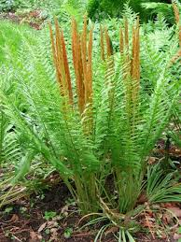
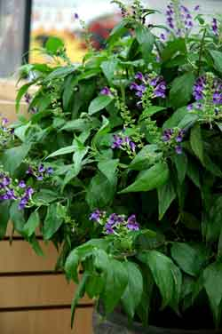
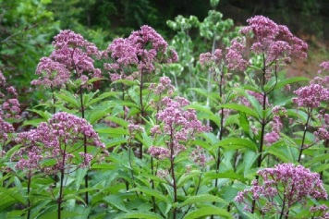
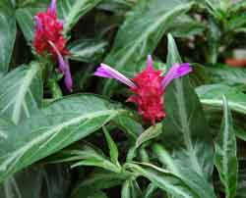
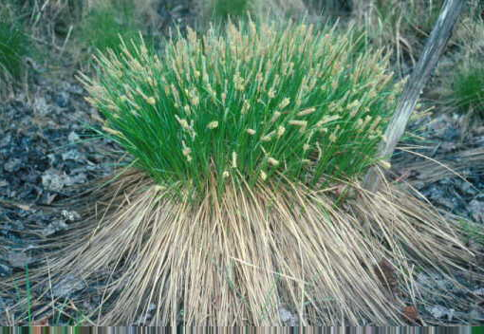
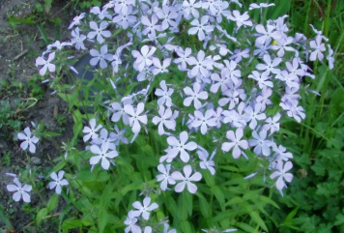
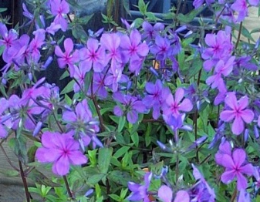
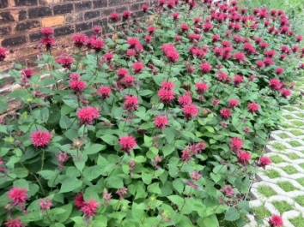
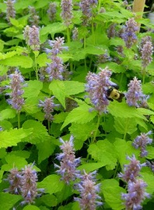
LOW IMPACT DEVELOPMENT
Plant Species:
Beebalm
Blueflag Iris
Cardinal Flower
Great Blue Lobelia
Broomsedge
Switch Grass
Lyre-Leaf Sage
Spicebush
Virginia Sweetspire
Florida Leucothoe
Spicebush
American Hornbeam
Silky Dogwood
Cinnamon Fern
Royal Fern
Netted Chain Fern
Sensitive Fern
Foamflower
Green And Gold
Cardinal Flower
Jewelweed
Flow Through Planter Plant Species
Resilient to insects and disease, and are less likely to need pesticides.
Best adapted to local conditions, e.g., no need to use chemical fertilizers.
Conserving water once plants are established in the right place, no need for supplemental watering.
High habitat value provides food, shelter, and nesting areas for birds and bees.
Planters on north exposure of buildings require a different plant pallet.
19
PEARL DISTRICT

Slide 20
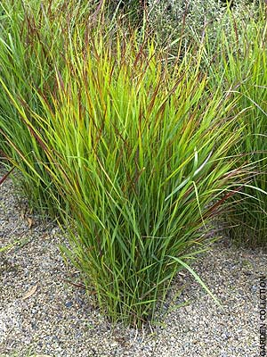
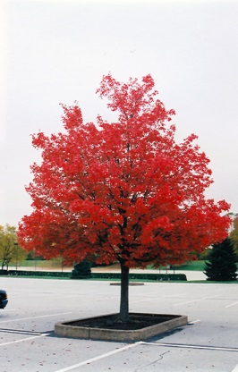
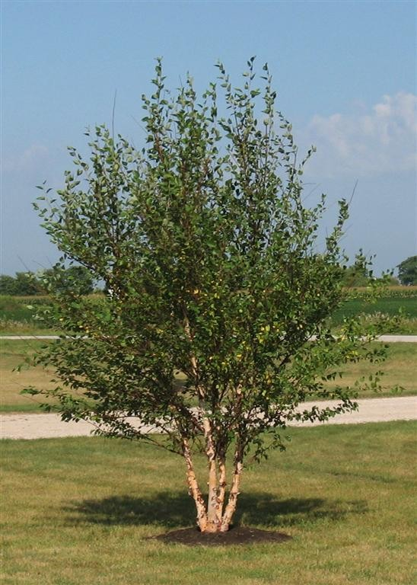
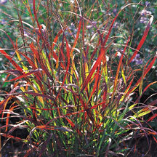
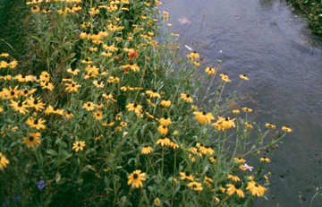
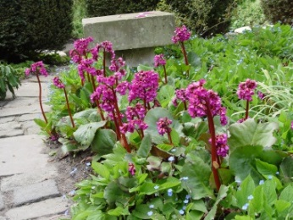
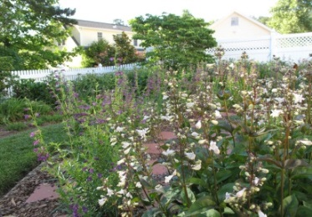
LOW IMPACT DEVELOPMENT
Canal Plant Species
Native Oklahoma species
Grassland planting and native prairie seed mix
Transition from prairie seed mix to native shrubs, ground covers, and flowering plant
Exhibit an attractive appearance.
Plant Species:
River Birch
Red Maple
Big Bluestem
Little Bluestem
Switchgrass
Foxglove Beardtongue
Fragrant Sumac
Red Beardtongue
Blue Wood Aster
Heartleaf Bergenias
Canna Lily
20
PEARL DISTRICT

Slide 21
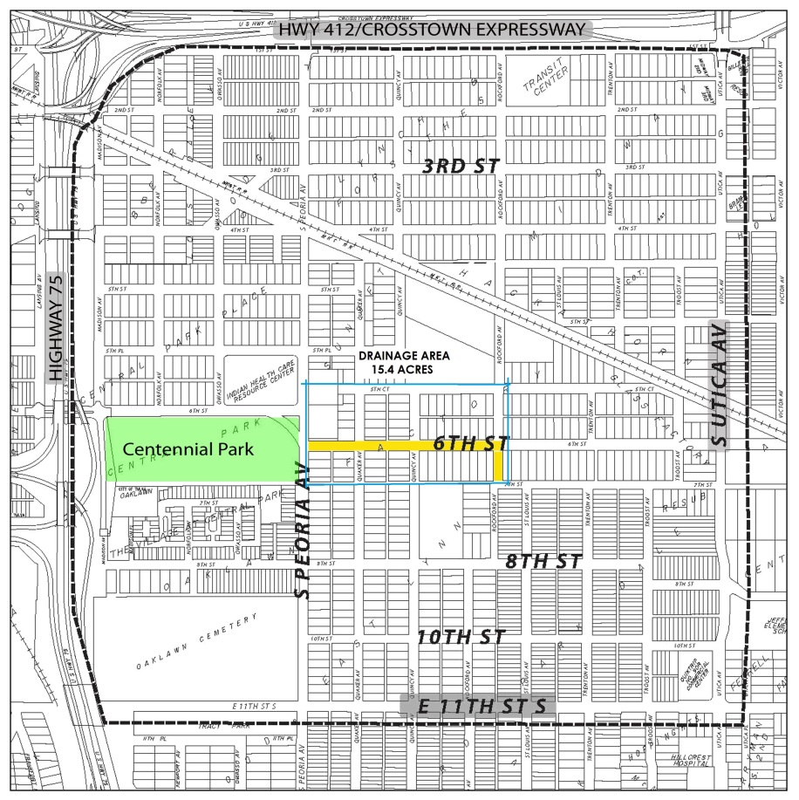
We won't have a society if we destroy the environment.
- Margaret Mead
HYDROLOGIC METHODOLOGY
The hydrological analysis of the Pearl District development compares our proposed LID design with the existing conditions and with the site if it was in its natural, pre-developed state.
The goal of our LID design is to achieve a fully developed site that reduces stormwater runoff flow rates to near pre-development rates while remaining economically feasible and providing opportunities for a vibrant, mixed use development.
The site was analyzed using Natural Resources Conservation Services (NRCS) formulas to calculate storm runoff volume, peak rates of discharge, and storage volumes.
Stormwater Depths (from City of Tulsa)
24 Hour Precipitation
5-year 4.98”
10-year 6.04”
100-year 8.75”
SCS EQUATION
Pe = (P – 0.2 S)2 / (P + 0.85)
S = (1000 / CN) – 10
P the magnitude of the storm event (inches)
Pe the runoff from the storm event (inches)
S the potential maximum retention (inches)
CN the site curve number
CURVE NUMBER EQUATION
CNC = (CN1 A1 + CN2 A2 … + CNj Aj) / (A1 + A2 … + Aj)
CNC the Composite Curve Number (CN)
Aj the area of each land cover
CNj the curve number for each land curve
21
PEARL DISTRICT
Link to detailed hydrologic justification.

Slide 22

HYDROLOGIC RESULTS
The 100-year Flow Rate Comparison indicates that the proposed LID design is significantly lower than the existing conditions (88.2 cfs versus 116 cfs), representing a flow rate reduction of approximately 74%. The values of the LID are slightly less than they are under natural conditions.
116.0
89.6
88.2
22
Link to detailed hydrologic graphs.
PEARL DISTRICT

Slide 23
“Water is the driving force in nature.”
― Leonardo da Vinci
HYDROLOGIC RESULTS
The weighted Curve Numbers indicate that the proposed LID design is approximately 15% less than the Existing Conditions and slightly less than the natural or pre-existing conditions.
Based on these calculations, the LID design will require less infrastructure to achieve greater stormwater control. In addition, construction and maintenance costs of the stormwater system are reduced and water quality and control are improved.
23
PEARL DISTRICT

Slide 24
ECONOMIC EVALUATION
CONVENTIONAL DESIGN versus LID
Additional Economic Factors:
Reduces downstream drainage infrastructure requirements.
Reduces potential for localized flooding within the watershed area.
Reduces use of potable water used for irrigation.
Improved health of the ecosystem and connected water bodies.
ELEMENT | LID |  | CONVENTIONAL
Storm Drainage | 4,195,000 |  | 4,202,500
Hardscape | 546,500 |  | 1,180,500
Softscape | 282,500 |  | 207,600
Architectural | 80,000 |  | -
Site Furnishings | 75,000 |  | 132,000
TOTAL | $5,179,000 |  | $5,722,600
24
Link to detailed cost estimate.
PEARL DISTRICT

Slide 25
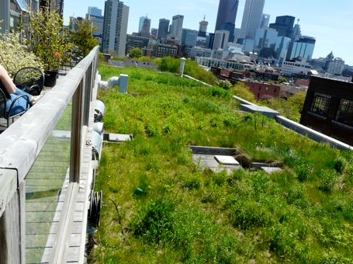
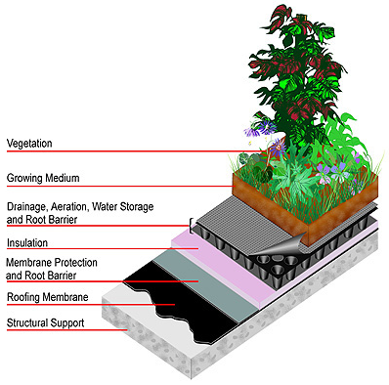
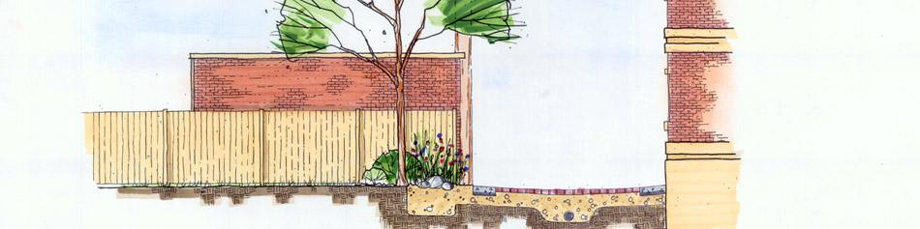
DESIGN GUIDELINES
Other Design Elements
In addition to the LID design methods included in our design, there are many other elements that should be considered during redevelopment of 6th Street and the Pearl District. We recommend developing guidelines to use during revitalization efforts.
These guidelines should include building materials that continue the historic feel of the district, paving materials, green roofs and green walls, street lights, street furnishings, signage, and artwork.
Green Roofs
25
PEARL DISTRICT
LID Parking Lot and Alley Design

Slide 26
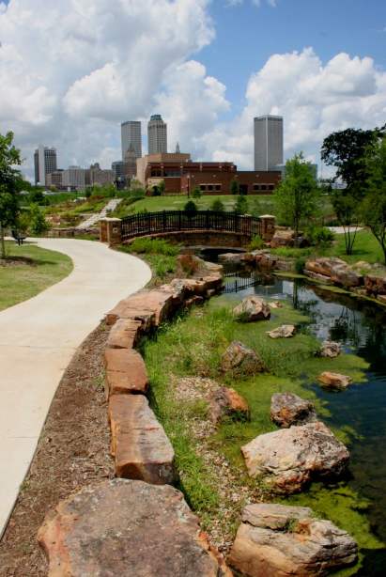






DESIGN GUIDELINES
26
PEARL DISTRICT

Slide 27
WHAT NOW?
Our proposed Low Impact Development design for the Green Pearl is only the first step. Continuing work with the City, the Pearl District Association, Oklahoma State University, and other organizations will encourage and support the revitalization and redevelopment of the area.
Educating the public, design professionals, and contractors of LID methods, illustrating the quality of life, and showing long-term financial advantages will increase the chances of success and sustainability of the developments.
POTENTIAL PROMOTIONAL OPPORTUNITES
We encourage public events within the Pearl District area to gain support for the project and future LID efforts. Events should be held in the street and buildings within the area. These include:
Farmers Markets
Art Exhibits
Outdoor concerts and performances
Walking tours
Community events with City Officials and Public Safety Departments
27
PEARL DISTRICT

Slide 28

CONCLUSION
Our proposed design for the Green Pearl continues to define the character of the Pearl District as a hub for culture and sustainability through the promotion of Low Impact Development to create an attractive, pedestrian-focused streetscape.
The Green Pearl project shows that a LID project can successfully provide an inviting pedestrian street, ecologically innovative, and fiscally responsible development.
A Place to Live
A Place to Grow
A Place to Learn
28
PEARL DISTRICT

