Slide 1

Harvest Waters 03_02

Slide 2





The Average Family
can use 400 gallons of water per day
(EPA, WaterSense)
over 30% is used for landscape irrigation
(EPA, WaterSense)
assuming 18 families would equate to 7200 gallons of water per day with over 2100 gallons used for irrigation alone
Harvest Waters

Slide 3
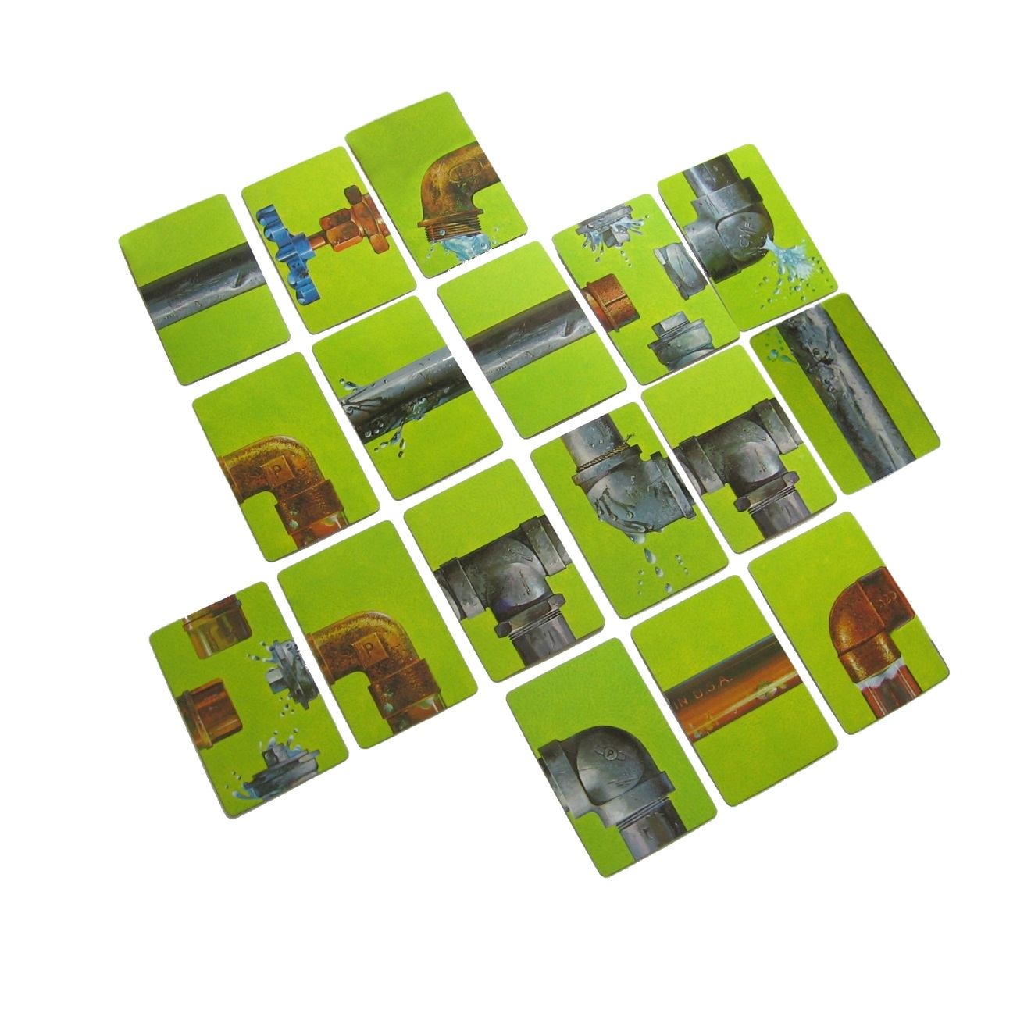
The Average Family
in Tulsa water comes from over fifty miles away in Lake Eucha and Spavinaw Lake
current water infrastructure is about fifty years old and was built with a fifty year life span
over the next twenty-five years our nation will spend one trillion dollars ($1,000,000,000,000) to provide and maintain that infrastructure
(AWWA, Buried No Longer)
Harvest Waters

Slide 4
Harvest Waters
Context _ Project Summary
The changes to traditional residential development we propose employ currently feasible technologies and well-established construction techniques in an integrated approach to creating an extraordinary low impact development. The central feature of the design takes what was historically poorly drained grassland which with ordinary development would become even higher runoff-generating urban land with contaminated water, to a new vision that is well-drained, purifying and that recharges the ground while making water available for harvesting on site. This design shows the feasibility of actually retaining more water on the site than an average rainfall produces—thus virtually eliminating contribution by the development to the city’s storm water system.
This new approach to site development is coupled with smart landscape design, energy saving home construction measures, and high efficiency ground source heat pump systems that work together to create a development that is both contextually sensitive and looks to the future. These mutually reinforcing goals of storm water retention and reuse, low-impact landscaping and energy efficiency can be achieved with a modest investment that yields real economic benefits to homeowners. The end result will not appear revolutionary to the neighbors, but it will fundamentally reorient the way homeowners and the city think about the impact of residential development; from a traditional model that places more burdens on city services to one that actually reduces those burdens.

Slide 5
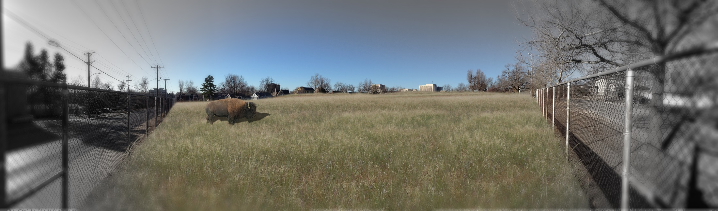
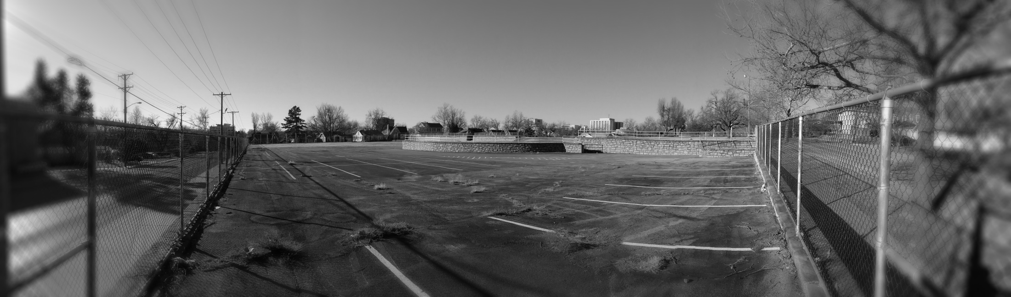
Predevelopment – millions of gallons of water did not fully infiltrate due to existing poor draining soils
Traditional Development– millions of gallons of water contaminated and then rushed to storm sewers

Slide 6
Harvest Waters
Context _ Rainfall
77– year average = 39.4 inches/year (Tulsa Int’l Airport 1938-2013)
100-yr storm event = 4.41 in/hour
Total water input Barnard site =
4.25 million gal/year

Slide 7

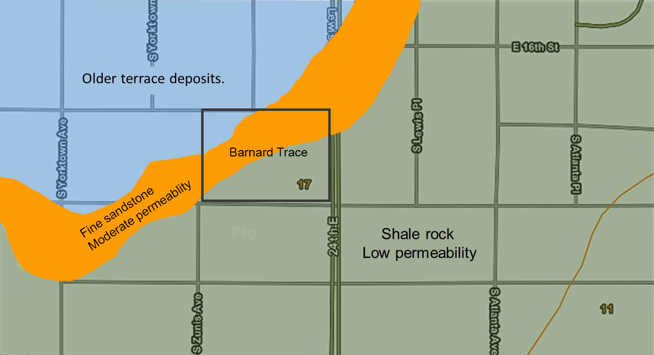
Harvest Waters
Context _ Geology
0
250
500 ft
Identified as Dennis Complex soil series 17:The soil is classified as poorly drained.

Slide 8
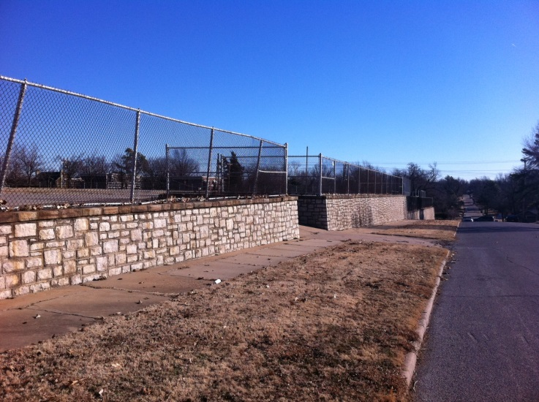
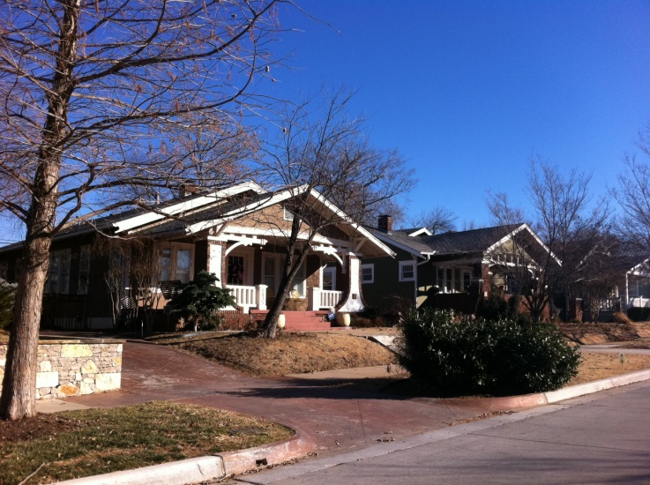
Harvest Waters
Context _ Site
challenges
Impervious built environment over impervious soil
Severe rainfall intensity
Poorly draining soil
Offsite water usage
Dramatic drop to street
Unknown future development of private lots
opportunities
Historically significant masonry wall
Interesting architectural context
03_02

Slide 9
Harvest Waters
Context _ Project Goals
environmental
Low impact: collect, filter, harvest, recharge, and use the on-site stormwater runoff in order to filter, lower, and delay the peak discharge into the city’s underground stormwater network;
Environmental sustainability: make provisions for sustainable measures such as geothermal technology, daylighting design, and reuse of water
contextual
Visual character: maintaining the existing character of the surrounding neighborhood
Historical value: maintaining most of the WPA retaining walls
economical
Minimize cost: minimize cost of site preparation by means of utilizing the existing infrastructure, minimize dirt removal, minimize areas of street surface
marketing
At least 18 residential lots, all of a desirable area and width
Pleasant neighborhood design: welcoming entrance, lots face major streets, detached garages in the back, discouraging through traffic, sense of a community, and smooth vehicular movement

Slide 10
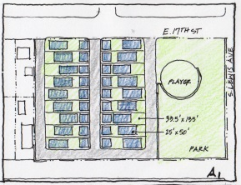
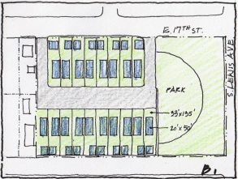
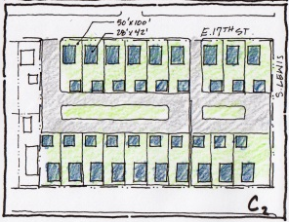
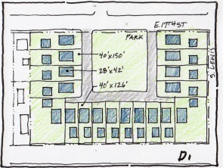

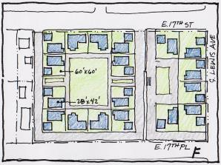
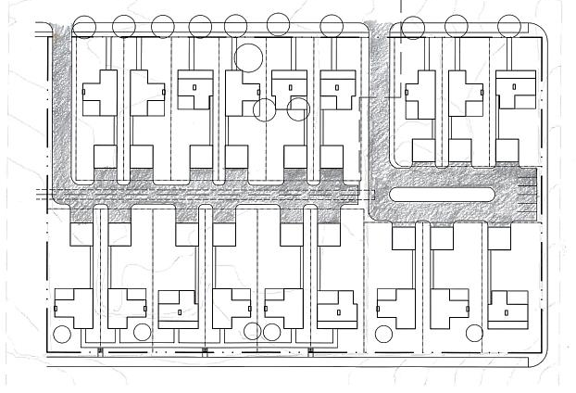
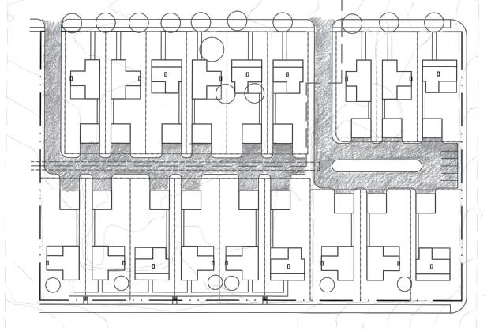
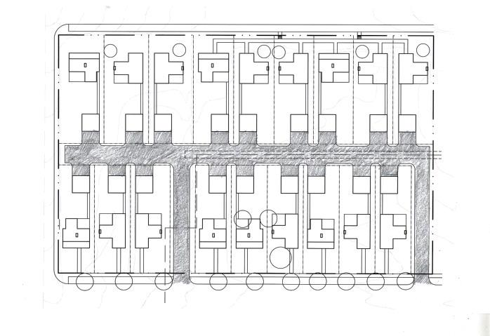
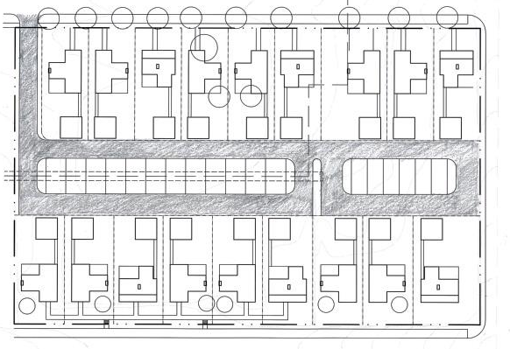
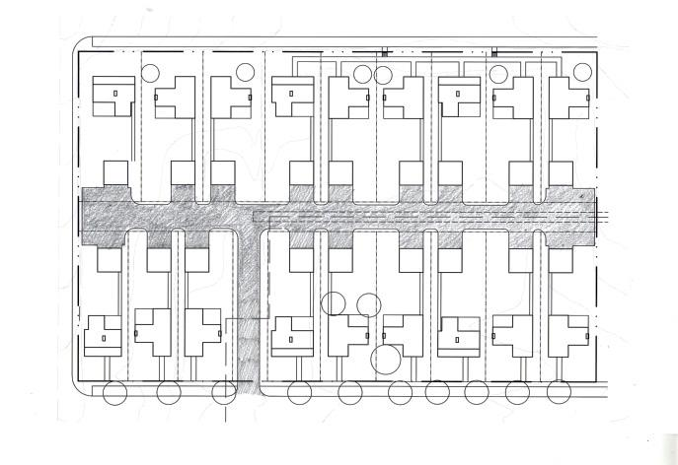
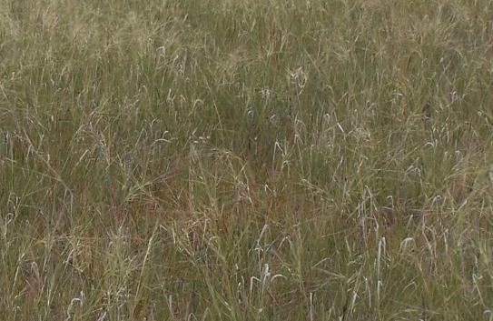
Harvest Waters
Context _ Exploration Schemes
early ideas
A. proposed plan- traditional B. proposed plan- LID C. through-drive plan- LID
D. garden plot plan- LID E. double cul-de-sac- LID F. grassland

Slide 11
Harvest Waters
Context _ Peak Discharge Assessment
Rational Method for Estimating Peak Discharge (cfs)
 | Storm events (in/hour)
 | 5-year | 10-year | 50-yr | 100-yr
 | 1.32 | 2.16 | 3.72 | 4.41
Scenario A | 2.87 | 4.69 | 8.08 | 9.56
Scenario B | 1.70 | 2.79 | 4.80 | 5.68
Scenario C | 1.67 | 2.74 | 4.71 | 5.57
Scenario D | 1.71 | 2.80 | 4.82 | 5.70
Scenario E | 1.68 | 2.75 | 4.74 | 5.61
Scenario F | 2.11 | 3.45 | 5.94 | 7.03
Scenario A – Proposed plan (No changes)
Scenario B –Proposed plan (with LID)
Scenario C – Adjusted plan (Through drive)
Scenario D – Common garden plan
Scenario E – Double cul-de-sac
Scenario F - Grassland

Slide 12
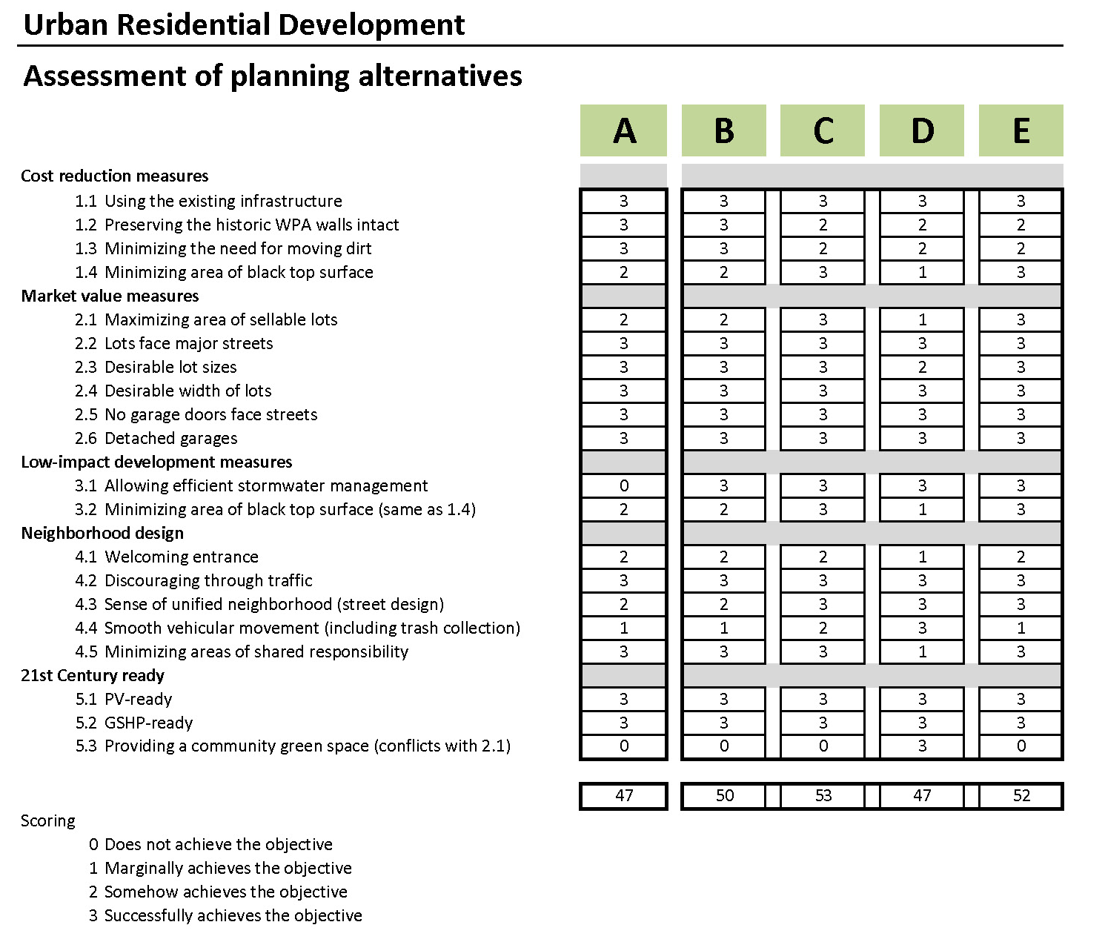
Harvest Waters
Context _ Plan Alternative Assessment
53
Scenario A – Proposed plan (No changes)
Scenario B –Proposed plan (with LID)
Scenario C – Adjusted plan (Through drive)
Scenario D – Common garden plan
Scenario E – Double cul-de-sac
Scenario F - Grassland

Slide 13
Harvest Waters
Context _ Site Progression
poorly drained soil
typical development compounding poorly draining soil with contaminated water
harvest waters development with well drained soil and water purification

Slide 14
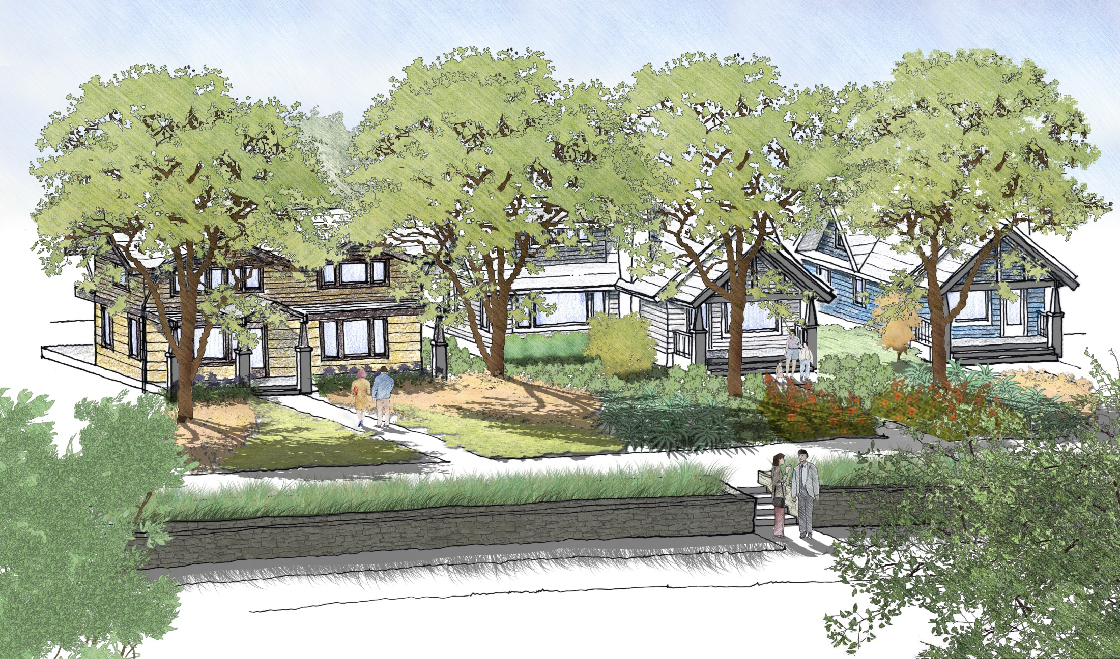
Harvest Waters

Slide 15
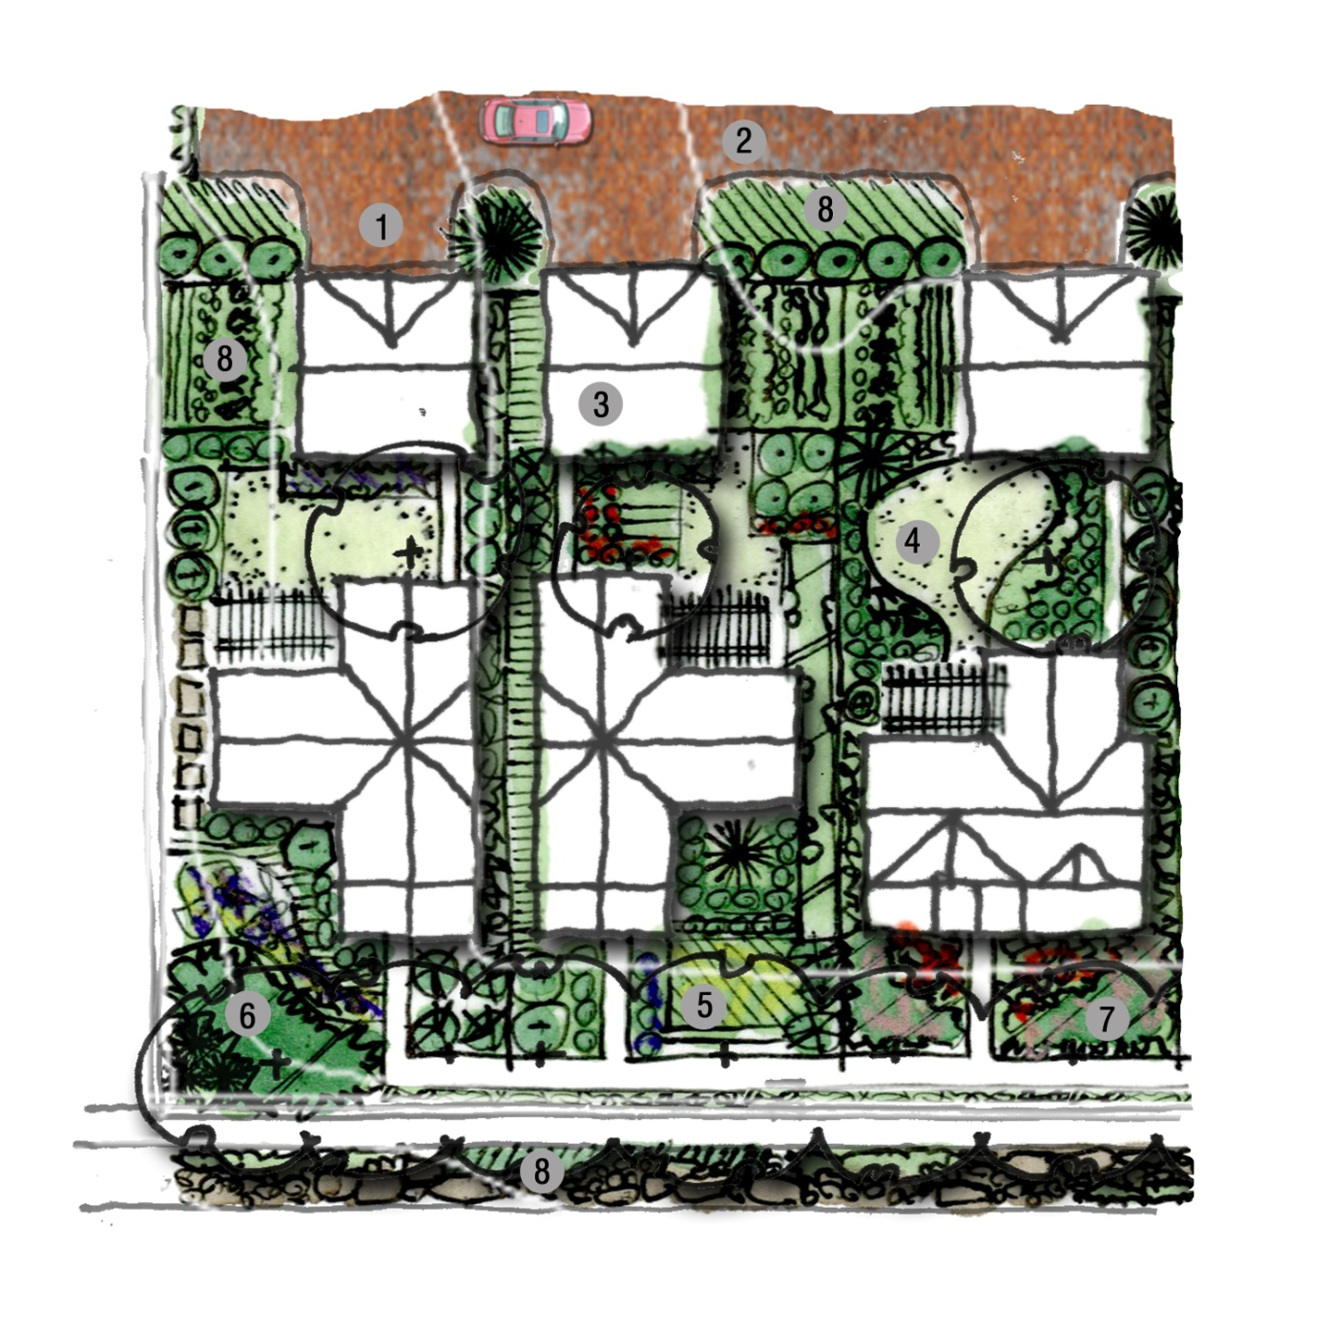
Design_ LID features (Typical)
water harvesting reservoirs
permeable paving
minimize footprint and paved surfaces
minimize turf areas
three trees per lot
increase landscape structure
create organic soil material
rain gardens
Harvest Waters [Lot Detail]

Slide 16
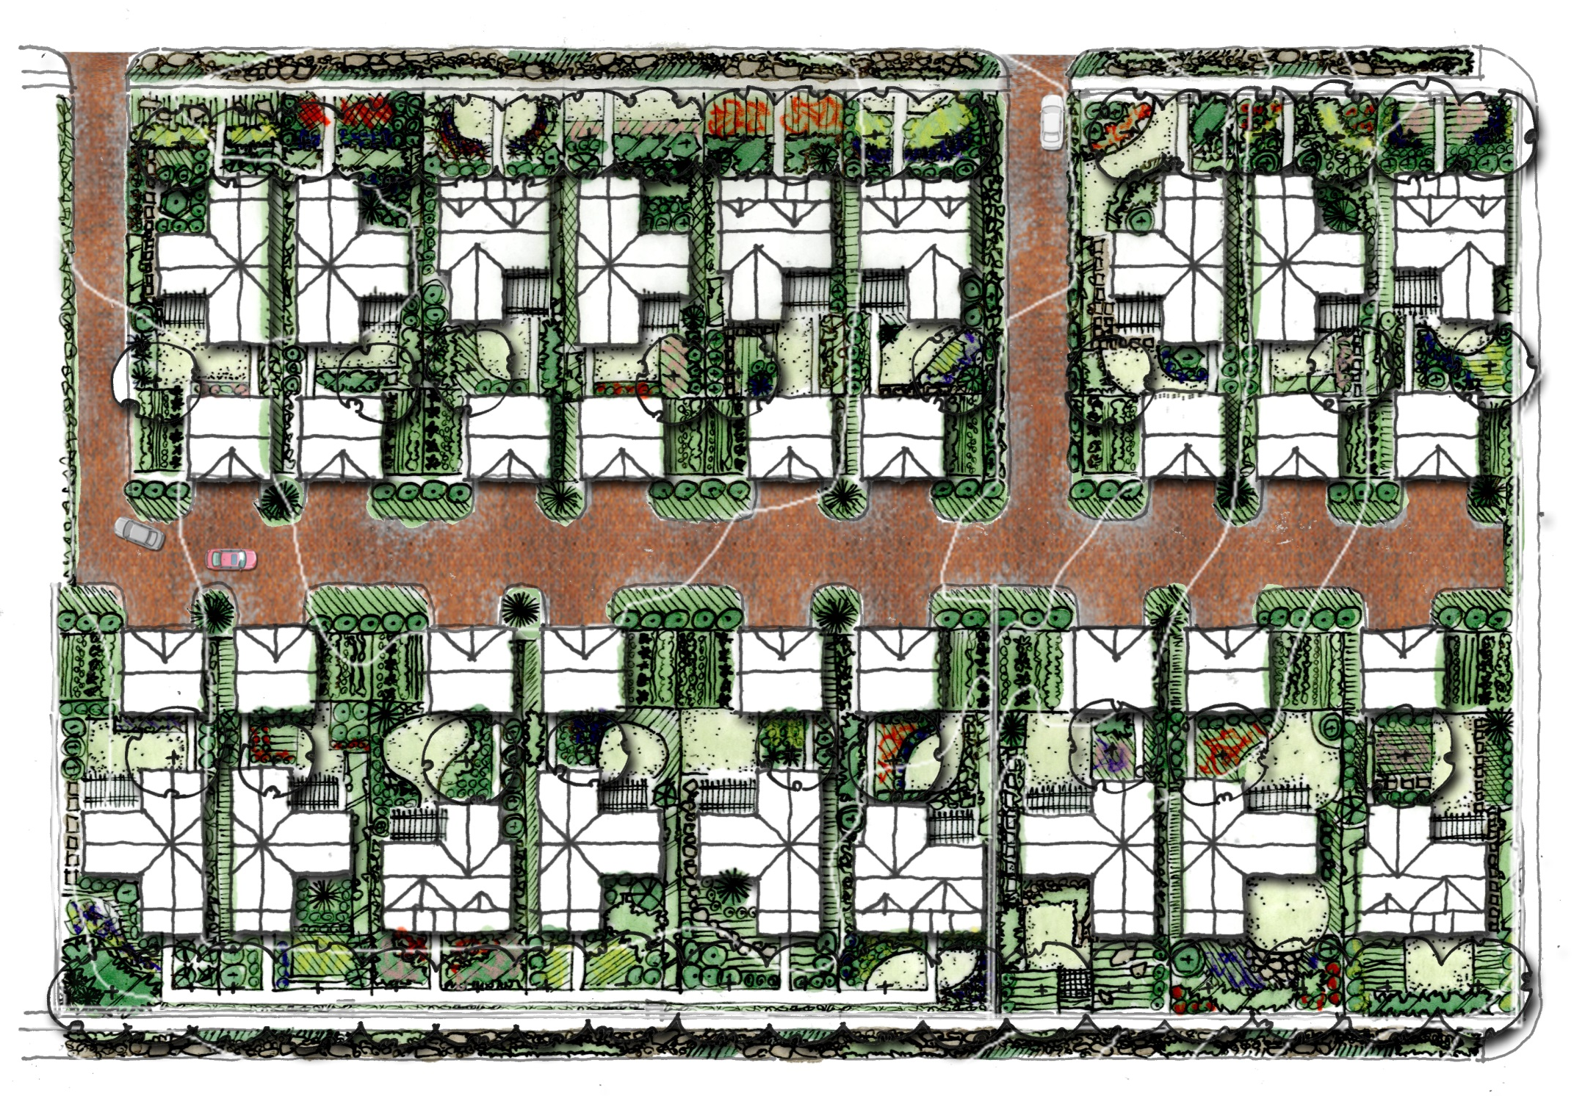
Harvest Waters [Development Plan]
North lots: 50’ x 151’ Fill for this area balanced with
South lots: 55’ x 151’ Wall excavation for cisterns

Slide 17
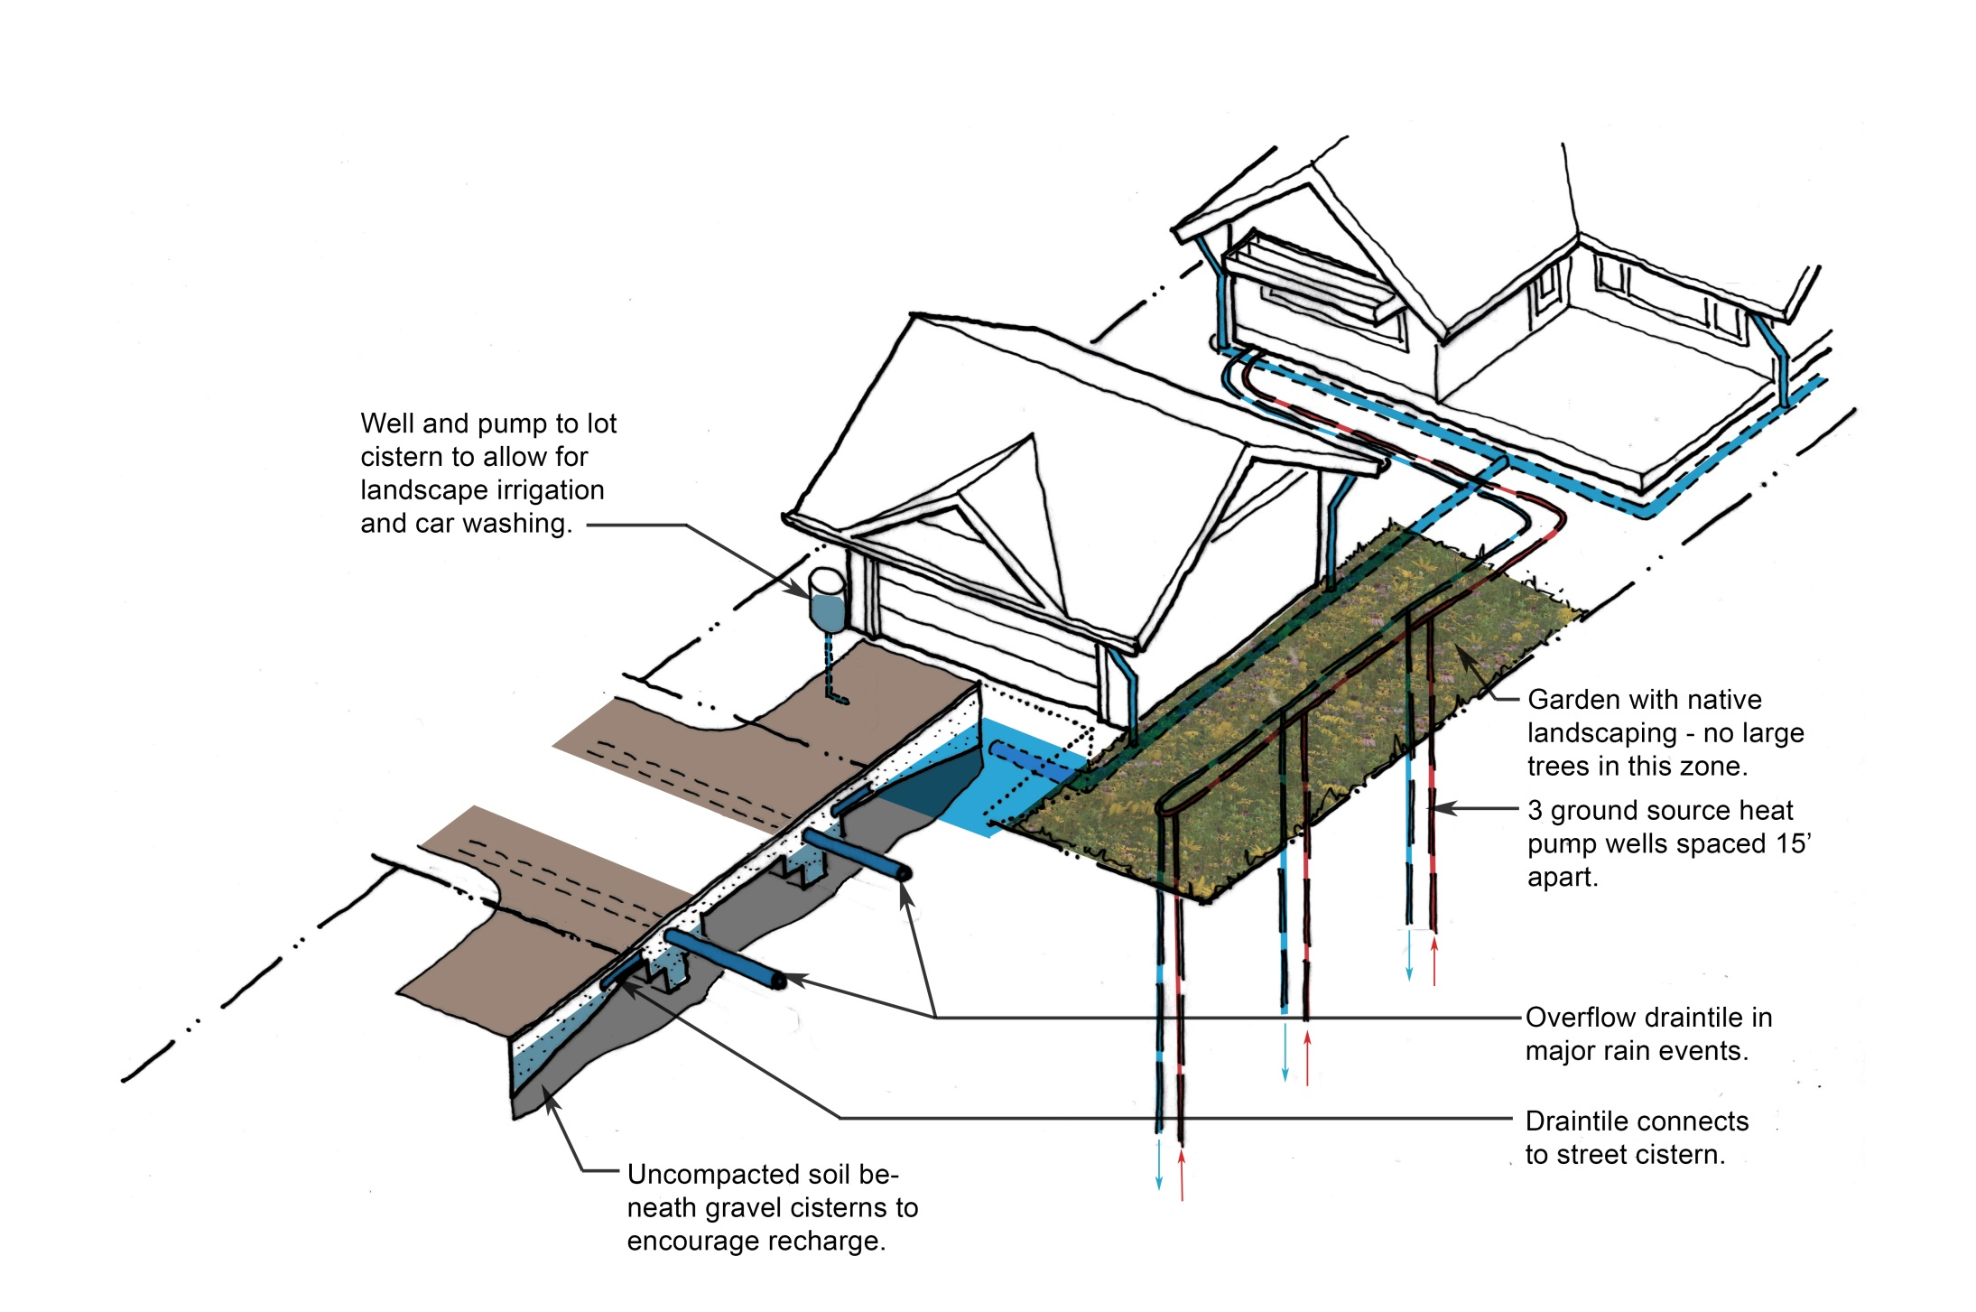
Harvest Waters [The New Infrastructure]
Design_ LID features (Typical)
Geothermal closed loop

Slide 18
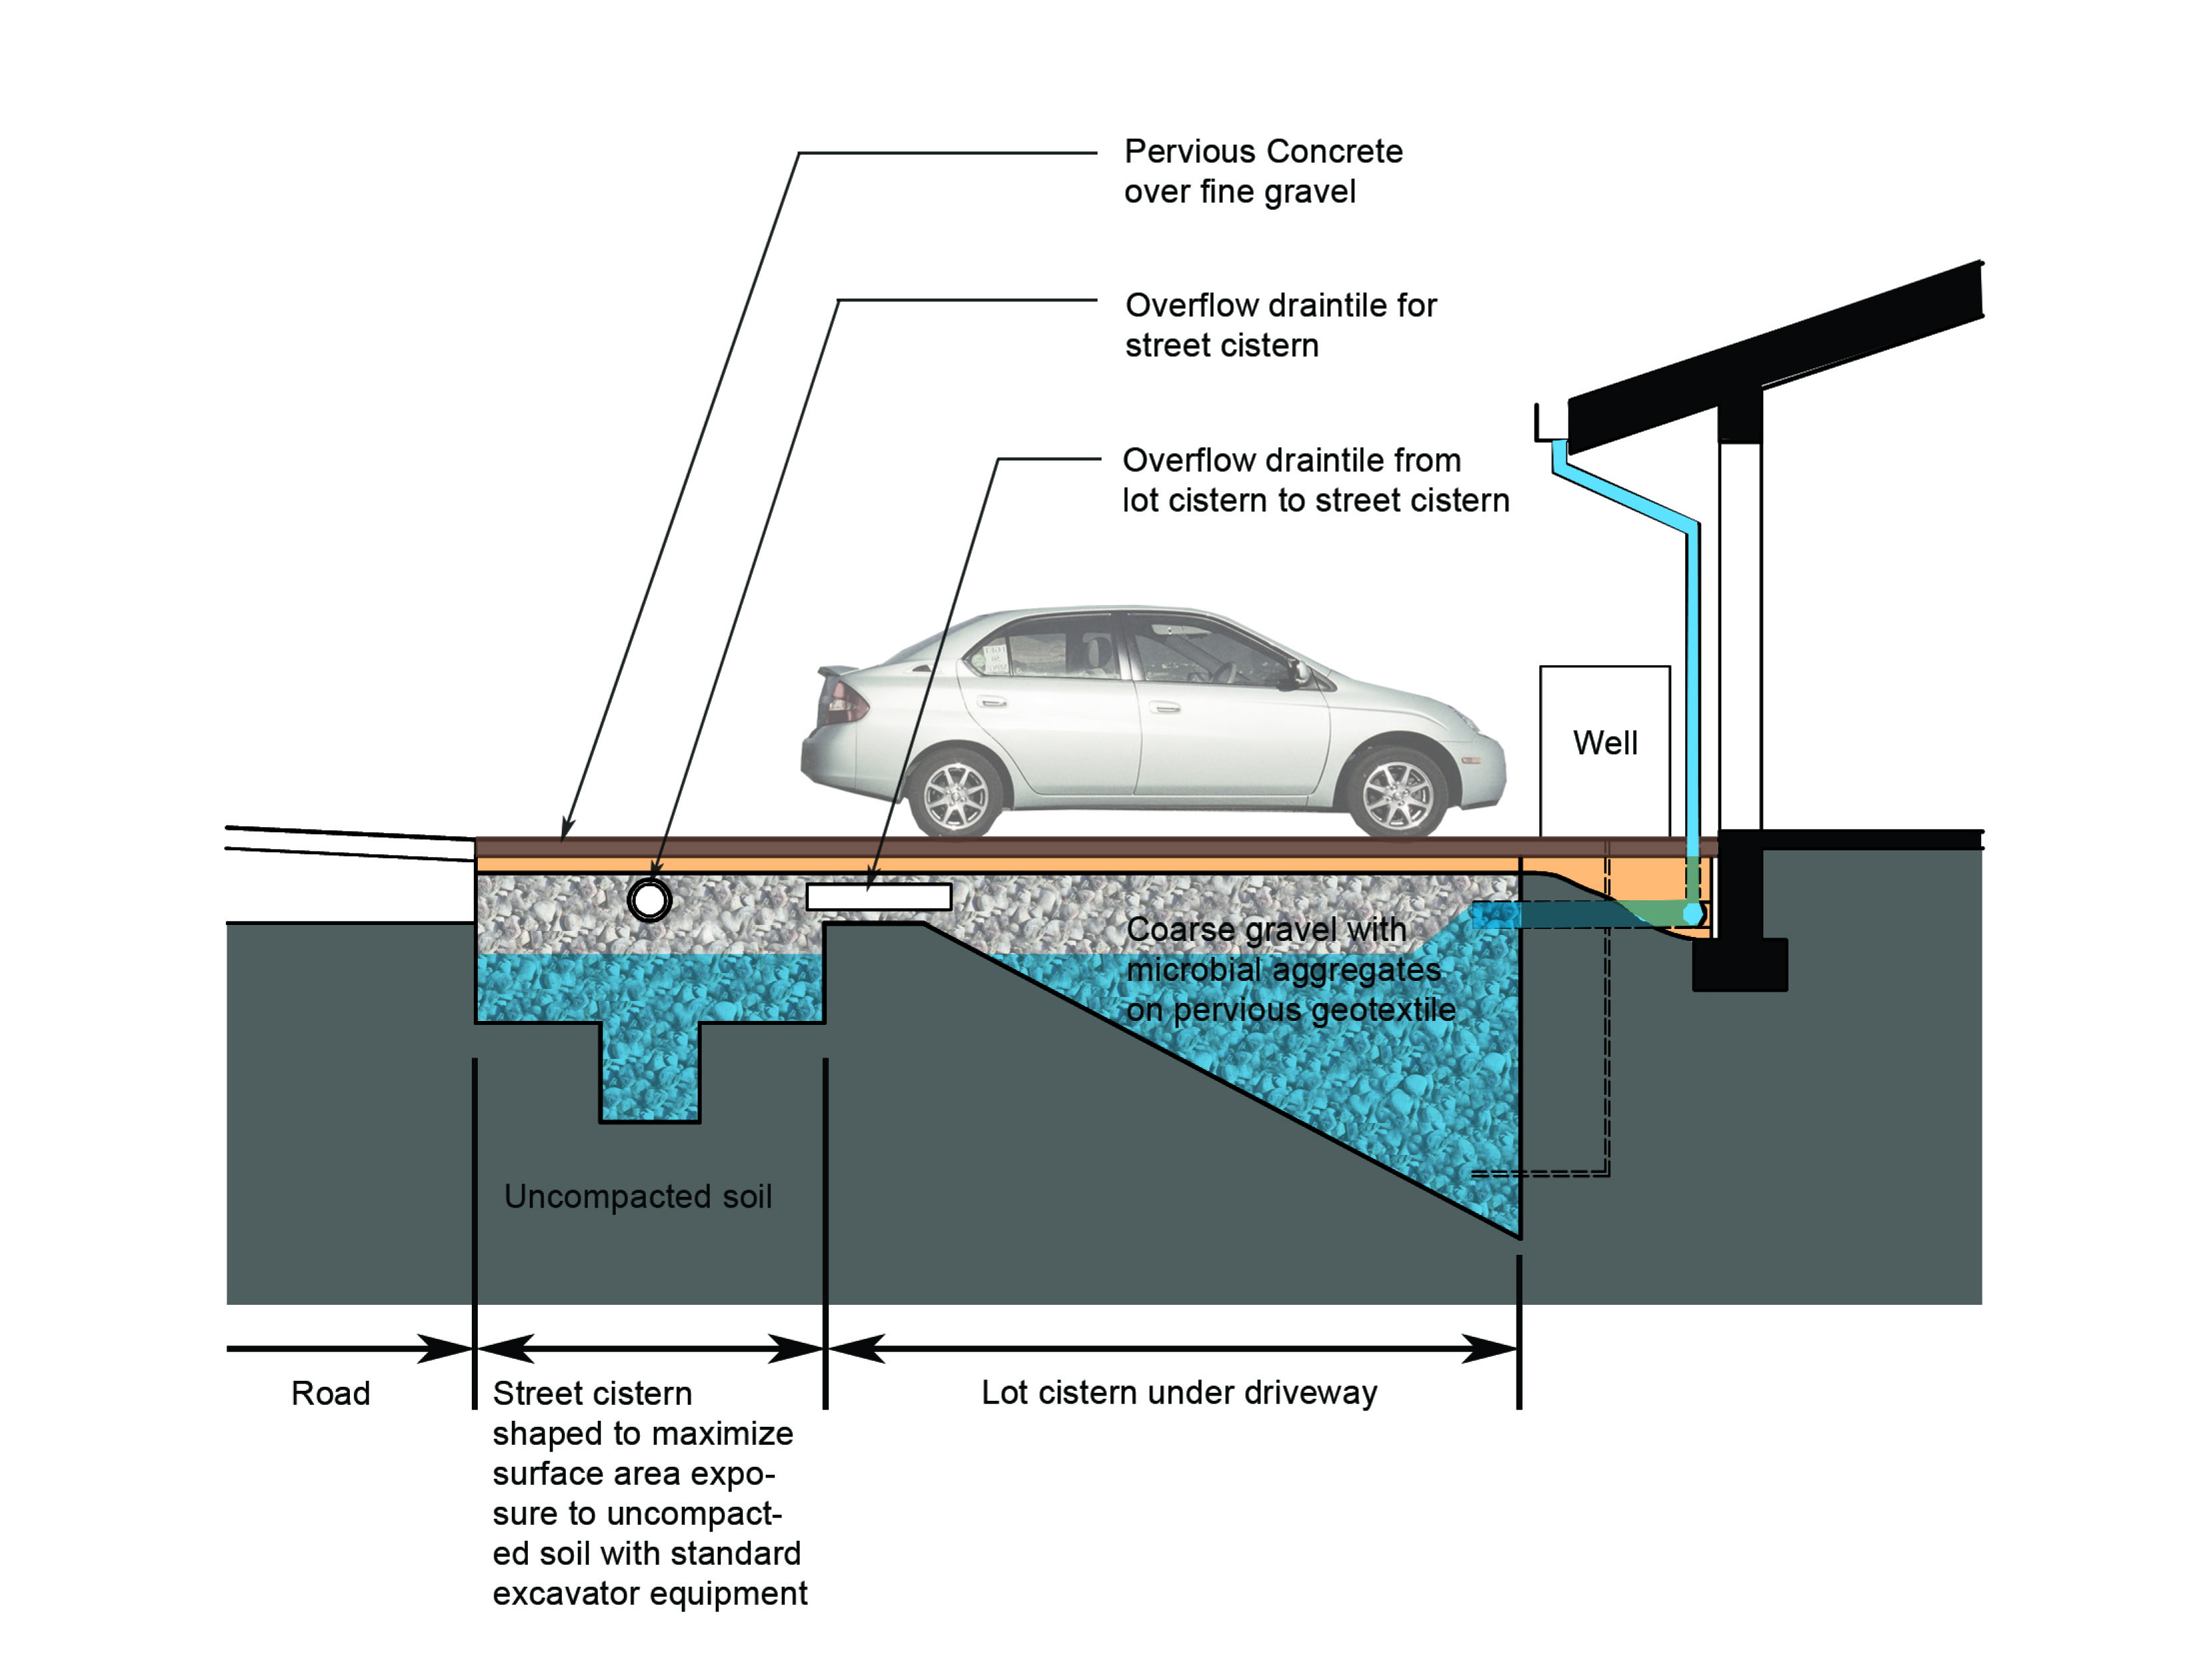
Harvest Waters [The New Infrastructure]
Design_ LID features (Typical)

Slide 19
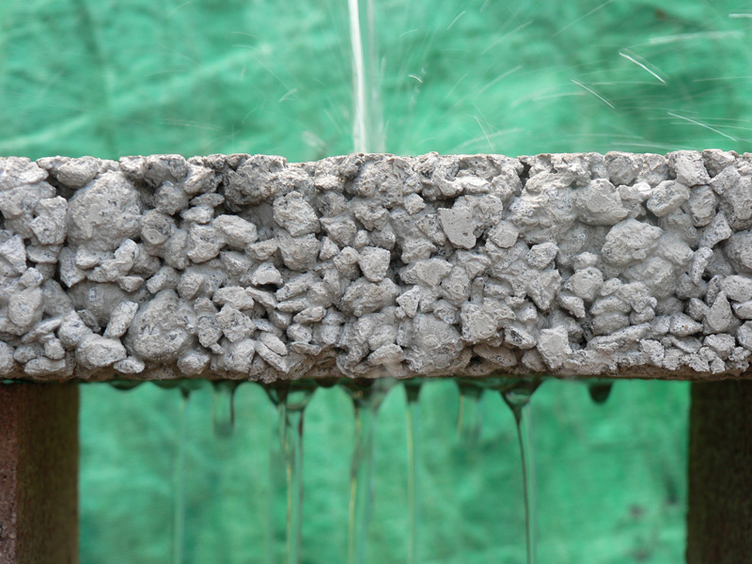
Harvest Waters [The New Infrastructure]
Design_ LID features (Pervious Concrete)

Slide 20
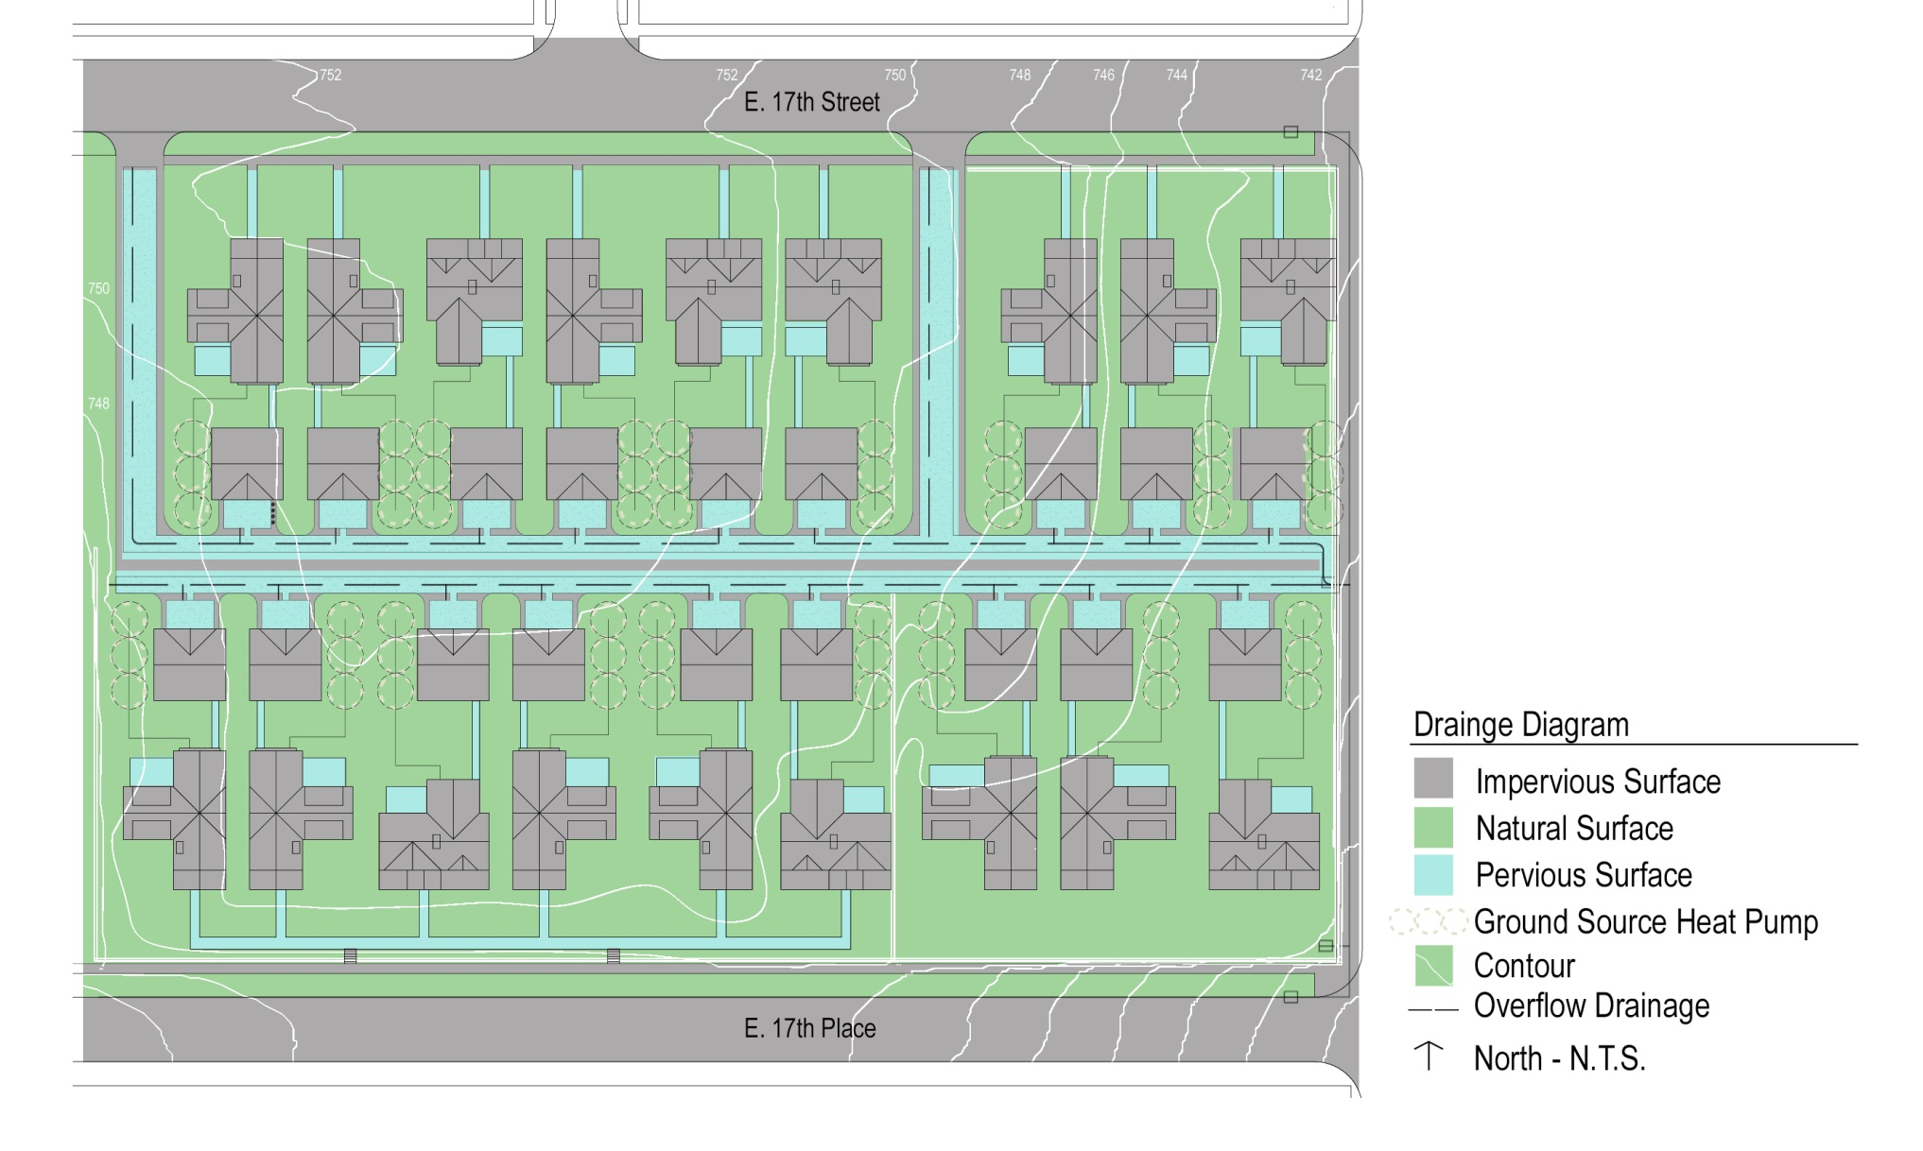
Harvest Waters [The New Infrastructure]
Drainage features (Typical)
Sufficient storage capacity to harvest a 1 inch rainfall
Stormwater storage in a single residential lot: 8400 gal
Total development stormwater storage: 150,000 gallons

Slide 21
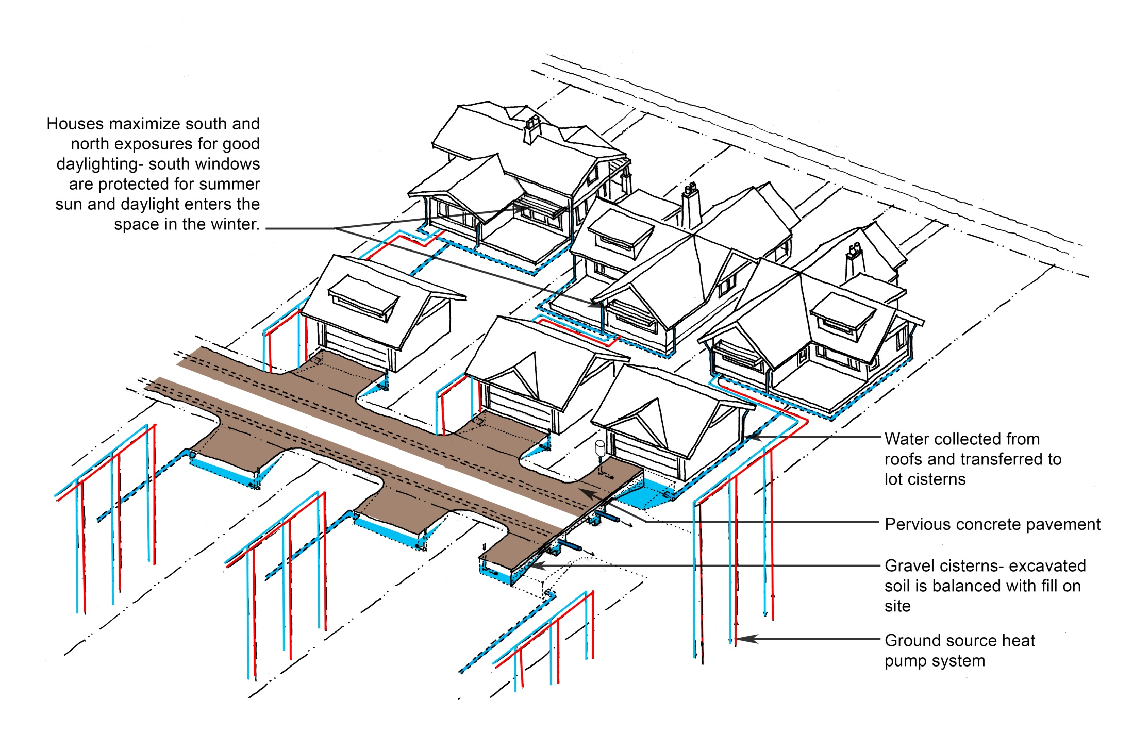
Harvest Waters [The New Infrastructure]
Design_ Architectural features (Typical)
Geothermal closed loop

Slide 22
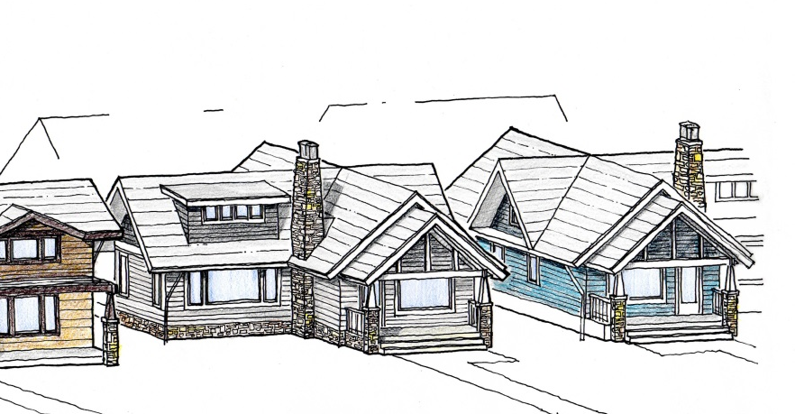
Harvest Waters [The New Traditional Architecture]
Design_ Architectural features (Typical)
Maximum north and south exposures capitalize on daylighting
Deep roof overhangs reduce summer heat loads and facilitate rainwater harvesting
Winter sun assists in heating
Each room connects with an outdoor space
Water collected with durable concrete roof tiles is cleaner than most options
Each house utilizes a 3-ton ground source heat pump system and highly insulated construction of the house
Roofs PV panel ready

Slide 23
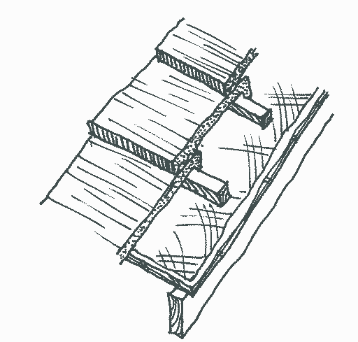
Design_ Architectural features (Typical)
Concrete Tile Roof
Concrete tile is to be specified to improve the thermal performance of the roof, increase its longevity, and to make for cleaner stormwater runoff into the cisterns. The $6000/house cost of the concrete tile upgrade will be largely offset by:
increased property values
lower property insurance costs
lower repair costs
less frequent replacement
improved thermal performance of the house
Ground Source Heat Pump System
Net cost of upgrade from conventional system: $8,000.00
Savings: $800.00 annually (7% rate of return over 20 years)
Total annual savings is $1,115.00 per home from an approximate $14,000.00 initial investment.
Harvest Waters [The New Traditional Architecture]

Slide 24
Design_ Project cost comparison
OLD DESIGN |  | NEW DESIGN
Impervious Road and driveways | $140,000 | Pervious Concrete Road and driveways | $156,000
Curb & gutter | $40,000 | Curb & gutter | $0
Hauling off site | $12,600 | Hauling off site | $0
Lateral drainage, catch basins & stormwater structures | $15,000 | Lateral drainage, catch basins & stormwater structures | $0
Cisterns | $0 | Cisterns | $120,000
Total | $207,600 |  | 276,800
The net initial cost difference is approximately $70,000 or $3,900.00 per lot.
ANNUAL SAVINGS
30,000 x $.0083 (City of Tulsa water + sewer rate) | $250.00 / year
City stormwater annual fee per house | 65.00 / year
Total annual savings | $315.00 / year
Savings:
$3,900.00 per unit cost / $315.00 = 12.3 year payback period or a rate of return of approximately 5% over 20 years.
Harvest Waters [The New Infrastructure]

Slide 25

Design_ Trees
a mature medium sized tree will intercept over 1,000 gallons of stormwater every five years
including other benefits a medium tree provides an average net value of over $400 per year over the course of 40 years.
the overall value of 54 medium trees (3 trees per lot, 18 lots) over 40 years is over $850,000
(McPherson, et al)
Harvest Waters [The New Infrastructure]

Slide 26
Design_ Trees
Caddo Maple
Cedar Elm
Chinkapin Oak
Shatung Maple
Shumard Oak
Harvest Waters [The New Infrastructure]

Slide 27

Proposed Code Changes
establish state guidance for minimum standards for stormwater recharge
regulate amount of impervious pavement per lot
provide incentives for stormwater harvesting by eliminating or reducing the yearly stormwater management fee
establish a residential landscape ordinance to require a three tree per lot minimum
Harvest Waters

Slide 28
Harvest Waters

