Slide 1
Barnard Trace
Low Impact Development
Urban Residential Redevelopment
Team 03-01

Slide 2
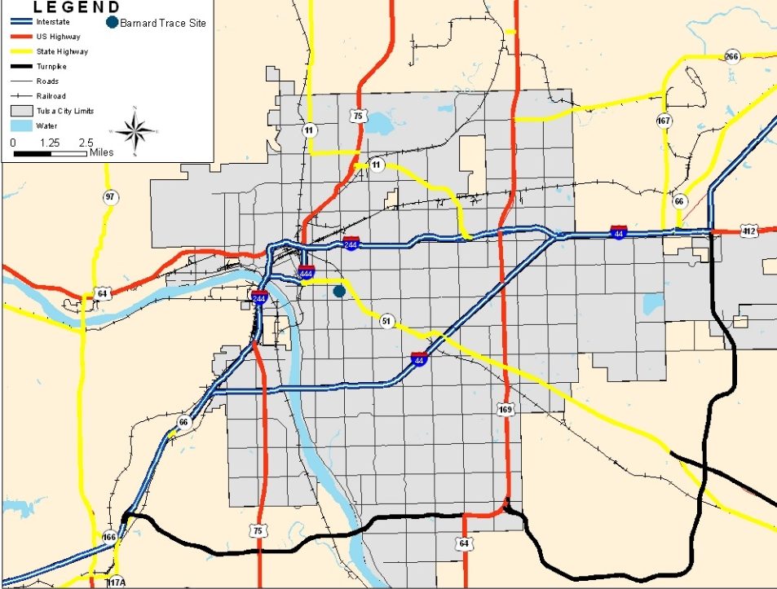
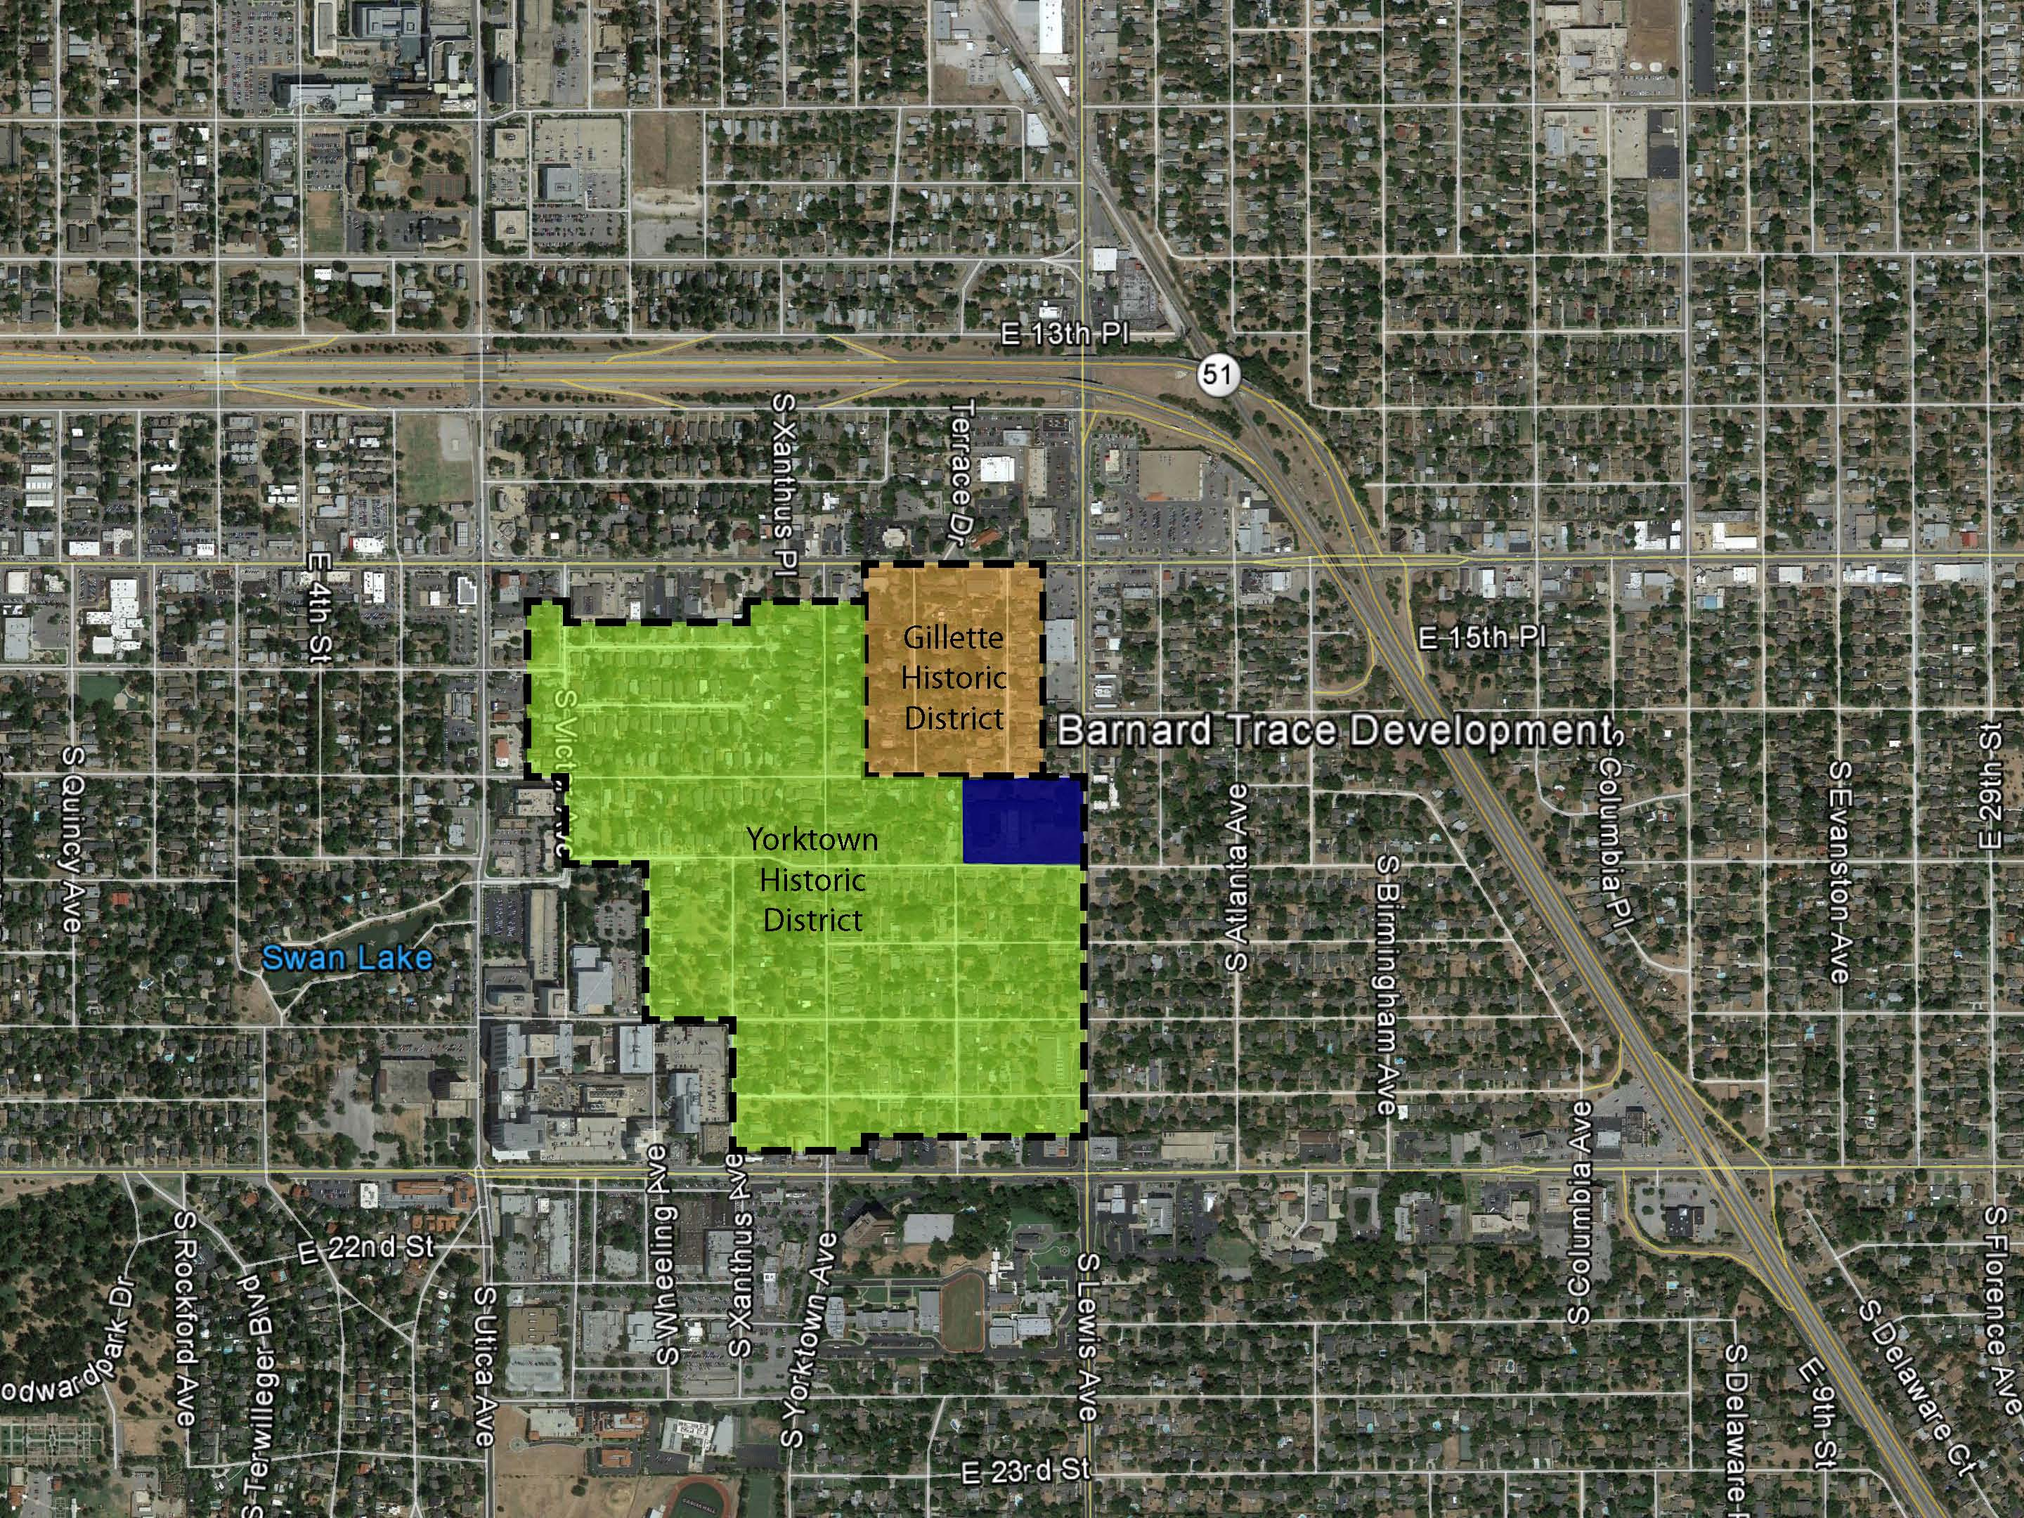
Site- Location
Tulsa, Oklahoma
Barnard Trace Development

Slide 3
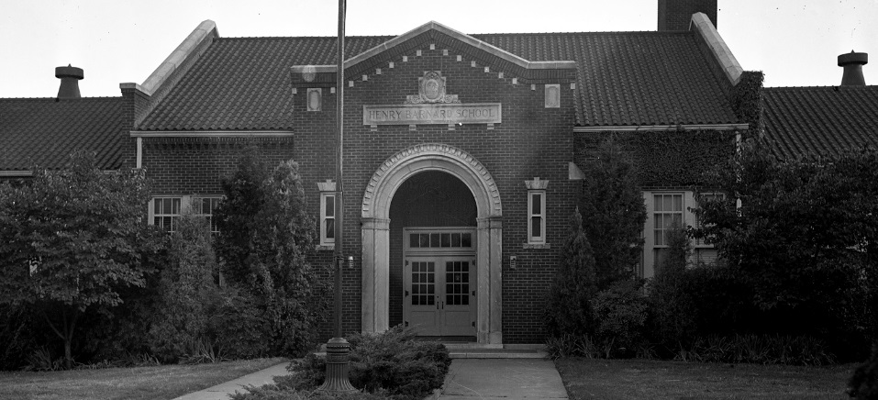
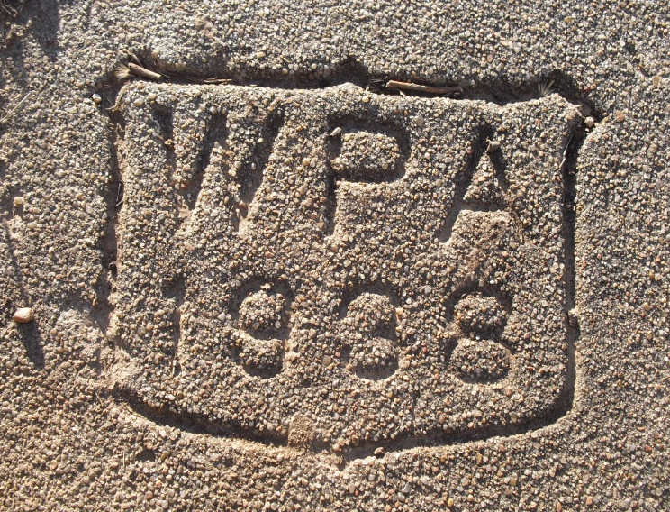
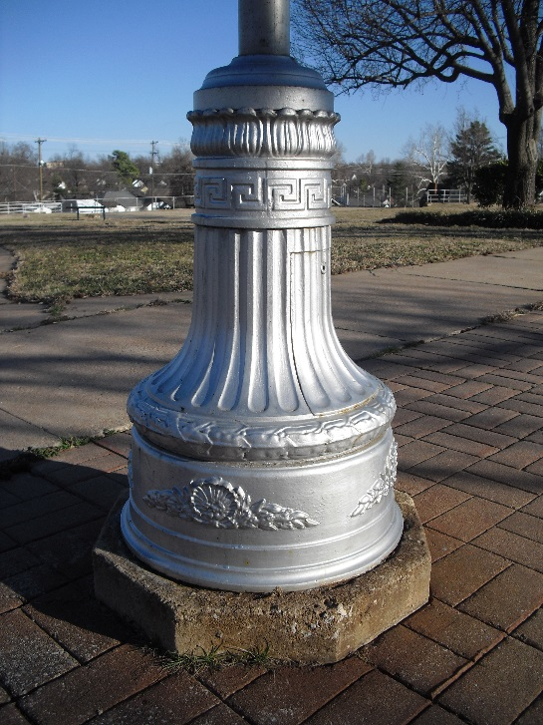
Site- History
Barnard Elementary School opened in 1925. Its iconic walls were constructed by the Works Progress Commission (WPA) during the Great Depression
The school operated from 1925 until 2011. Tulsa School for Arts and Sciences was slated to use the site starting in 2012
September 5, 2012, the school was destroyed in a large fire

Slide 4
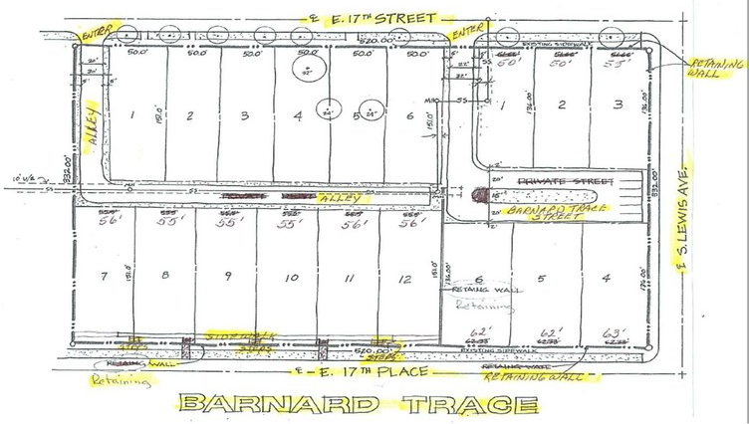
Site Design- Background
In 2013, the Barnard School site was sold for residential development
Proposals were highly scrutinized by community members.
Existing Site Design with 18 single family lots

Slide 5
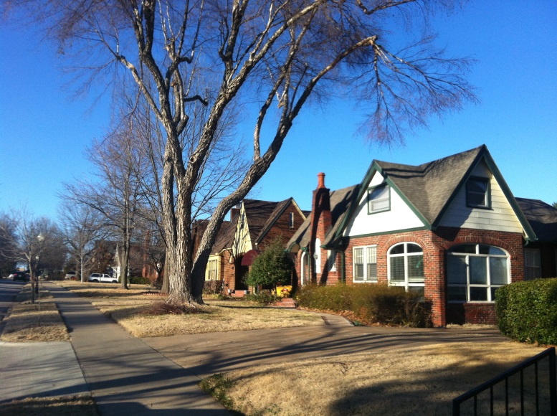
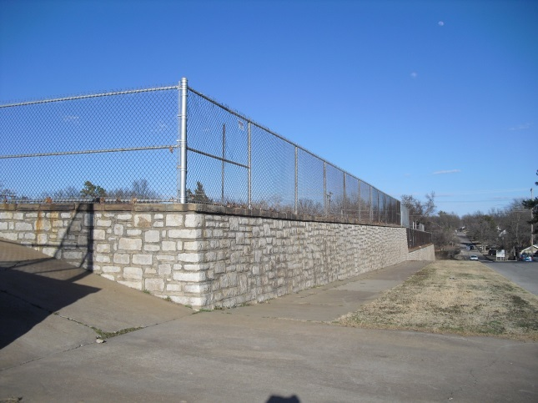
Site Design- Constraints
The design needs to provide at least 18 residential lots
Building sizes and types need to maintain the look and feel of the local neighborhood
Consider the historic and signature WPA walls into the development
Utilize LID design principles and goals
Consider pollution impacts on Crow Creek

Slide 6
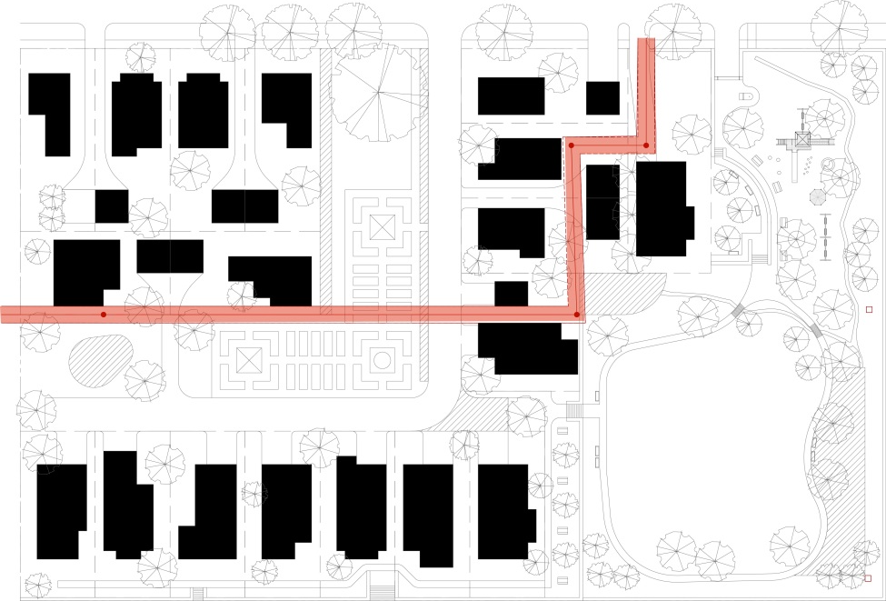

Design- Overview
This design envisions a community of single-family detached houses juxtaposed to a park created through cluster/conservation development strategies.
This park creates a genus loci that honors the site’s history, provides for residential recreation, and ensures ecological functionality. A community garden reinforces those principles.
Greenspace, permeable pavement, bioswales, and rain water cisterns are all incorporated into an LID design.
Cluster development is the primary LID concept used in this design. This concept provides a number of benefits. First, this enables shrinking overall street and utility line length. Second, it allows for a large tract of open space to be preserved for the enjoyment of the community. Third, it enables the use of structural LID controls, such as bioretention and pervious pavement, in more easily managed common areas.
To reduce imperviousness, the design contains shared driveways, no curbs, and hammerhead turnarounds (20’ x 60’) rather than a cul-de-sac.
Historical elements (wall, school, utilizing existing stairways as assets) are incorporated into the design, and care was taken to tie in to historic neighborhood (design and flow).
The design includes community gathering spaces for the new and previously existing developments.
All structures are carefully arranged to avoid the existing utility easement for the sanitary sewer (see figure).

Slide 7
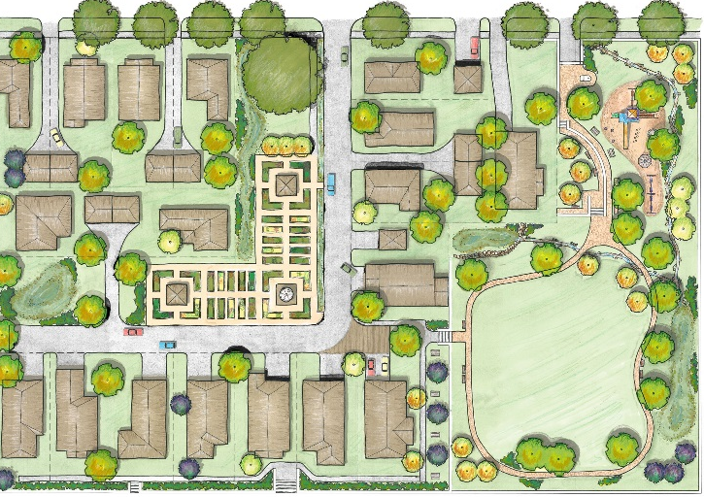
Design- Overview

Slide 8
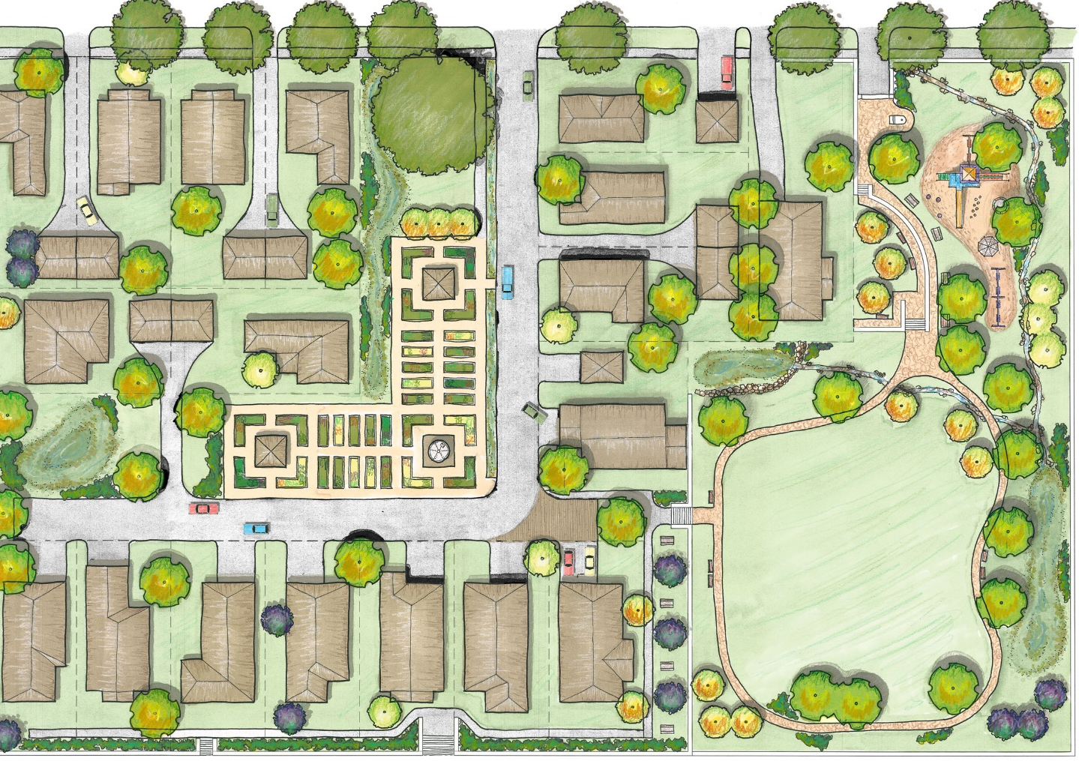
Design- Overview
Distributed bioswales and biorention cells reduce runoff and provide stormwater remediation
Cluster Development groups houses closer together on smaller lots.
Saved land area allowed for the preservation of 1.6 acres (40% of the site) of open space for the community that also buffers homes from Lewis Ave
Dry creek bed directs water flow and provides visual stimulation
Hammerhead turnarounds preserves space while allowing fire truck access to houses
Meadow area provides opportunities for recreation and ecological processes
Permeable paving provides additional infiltration areas for stormwater

Slide 9
Design- Overview
Existing street trees preserved
Iconic sweet gum tree and seating area preserved
Park entrances provides education materials through historic markers, archway, relocated flagpole and signage related to LID principles
Playground and sitting area provides spaces and opportunity for interactions between neighbors
Community gardens provide additional, functional open space for residents, and they promote community development
All WPA walls and stairways preserved and used as a community assets
Rainwater silo provides irrigation for the community garden
Walking trail with interspersed seating provides exercise and social interaction opportunities
New stairs built into existing entryway

Slide 10
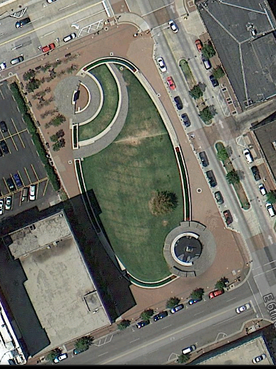
Design Elements- Park
Donation of the common area to a nonprofit, like Tulsa-based Land Legacy, to develop and manage would yield tax savings (about $160,000), reduce the cost to develop the land, and prevent the need for maintenance plans. The landscape design, including bioretention areas, is primarily drought tolerant and low maintenance native vegetation.
Land Legacy has a strong interest in developing “pocket parks” that provide urban leisure space, like Chapman Green in downtown Tulsa. When asked about the Barnard location, they thought the site had great potential, especially because of the lack of park space in the neighborhood and the historic nature of the site. Land Legacy would receive the donated space (upper and lower areas), fundraise, build, and manage the parks in perpetuity, or find someone who will.
Chapman Green in downtown Tulsa
A Land Legacy Park

Slide 11
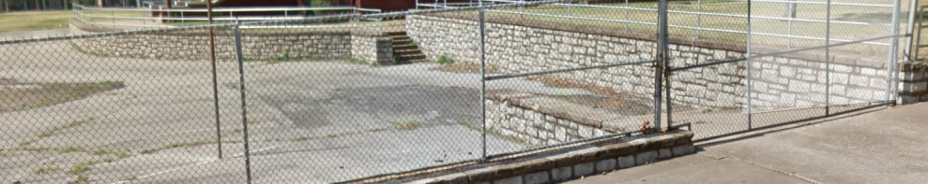
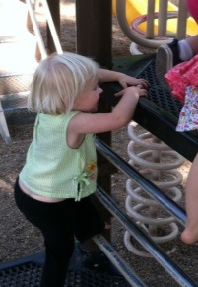
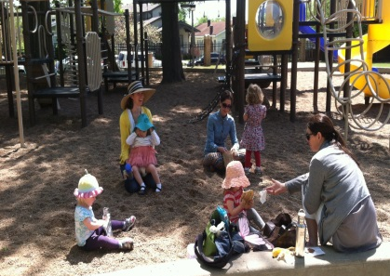
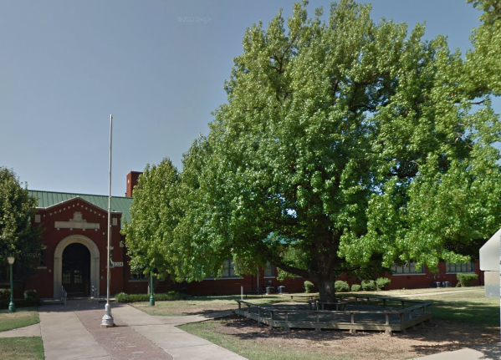
Design Elements- Park
The historic WPA walls are featured
as part of the public park.
Forty percent of the property (1.6 acres) will be maintained as community open space including:
  Playground
  Picnic tables and benches
  Walking trail
  Community garden
The historic school site will be honored:
  The main road coincides with the original walkway to the front entrance
  The large gum tree and seating area will be preserved
  The park entrance will be through an arch modeled after the main school entryway
  A monument to the school and preserved flag pole will be located near the park entrance

Slide 12
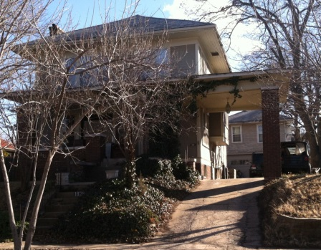
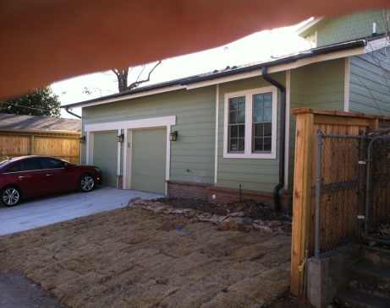
Design Elements- Public Acceptance
Public Acceptance was a top priority for the design team. Careful consideration in the design process allowed the redeveloped community to match the look and feel of the surrounding neighborhood and preserve historic features while integrating structural LID features and the preservation of 1.6 acres in community open space. Special considerations for public acceptance include:
Preservation of all of the WPA walls and stairways.
All homes along existing streets:
  Line up with adjacent properties
  Match look and feel of the community (to maximum possible extent)
    17th Street: no WPA walls allow homes to have common detached garages and/or carports
    17th Place: WPA walls necessitate rear car access and use of attached garages (see photo)
    (used newer reconstructed homes approved by the Tulsa Preservation Commission as a design model)
    Easternmost home to feature a covered, attached carport (as in figure above)
The unconventional lot sizes and shapes can all be found in this or adjacent neighborhoods.
  The frontage widths of homes on E 17th Street, just west of this development, vary from 40 to 50 feet.
  The depth of lots on E. 16th Street, just west of the development, are only 80 feet deep, with detached garages.
Forty percent of the property (1.6 acres) will be maintained as community open space including:
The historic school site will be honored:
  The main road coincides with the original walkway to the front entrance
  Multiple park features will honor the school (covered in previous slide)
Typical attached garage in
Yorktown Historic District
New home in Swan Lake Historic District

Slide 13
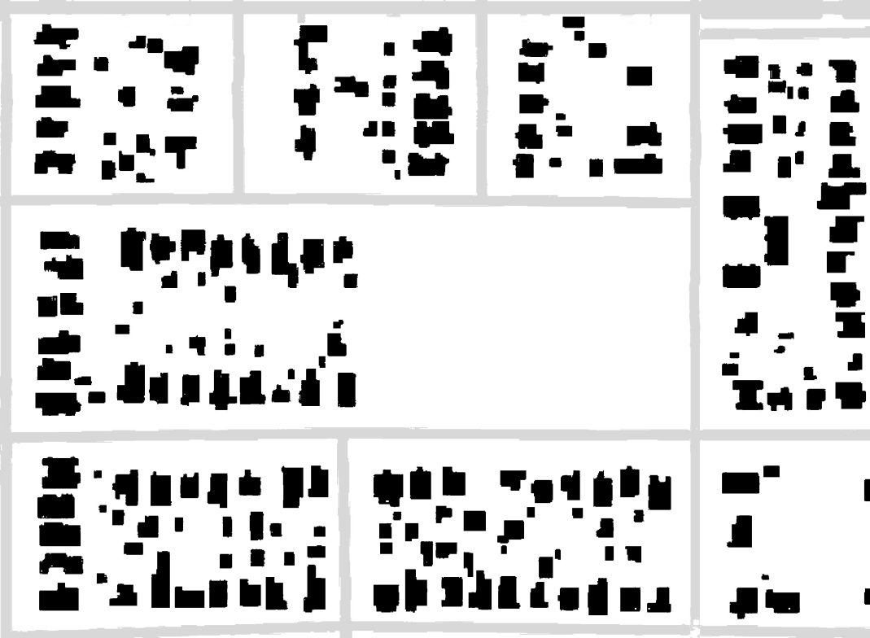
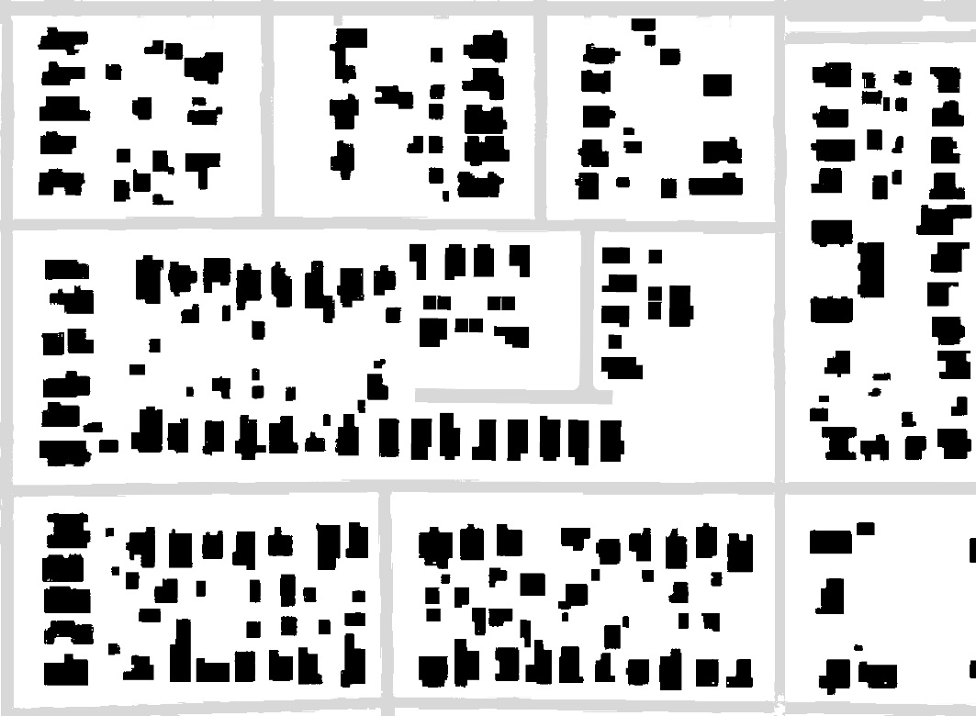
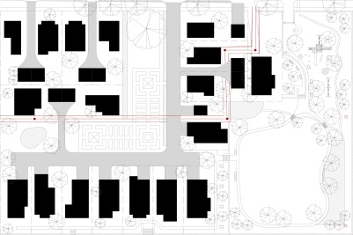
Design Elements- Overview
17th St.
17th St.
Lewis Ave
Lewis Ave
17th Pl.
17th Pl.
NTS
NTS
The design area is demarked by a red square.
Despite using smaller lot areas, the proposed buildings integrate into the existing urban fabric.
The open space preserved through cluster development practices will serve the proposed neighborhood and the surrounding community.

Slide 14
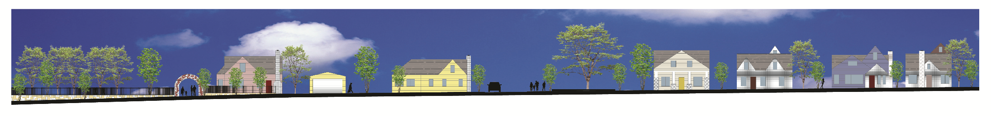


Design Elements- Neighborhood
Site elevation along 17th Street looking south into the proposed development.
NTS

Slide 15
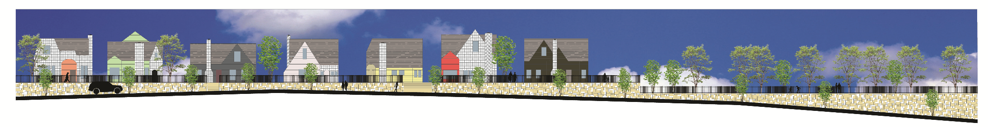
Design Elements- Neighborhood
Site elevation along 17th Place looking north into the proposed development.
NTS

Slide 16
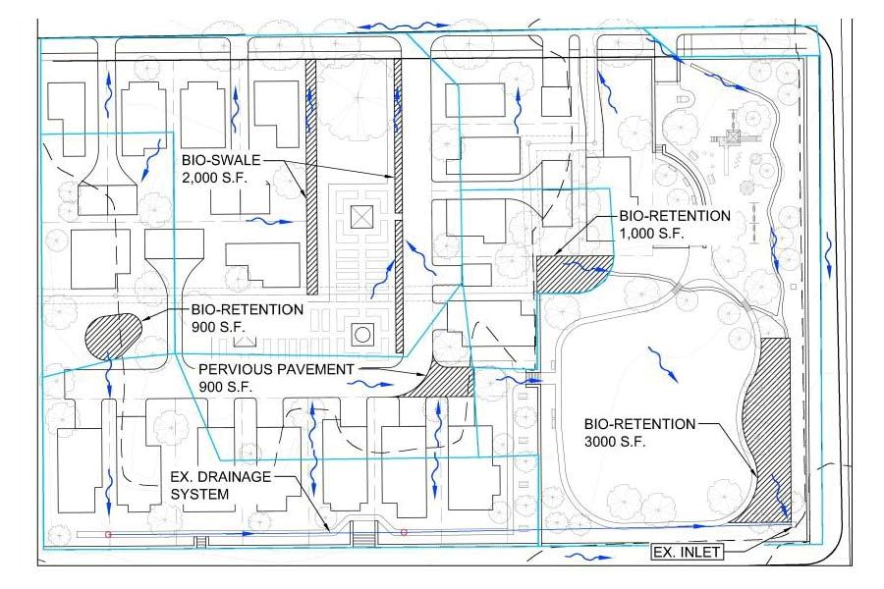
Design Elements- Stormwater
water flow
direction
Water recaptured from street

Slide 17
Design Elements- Stormwater
The drainage analysis was done using Autodesk Storm and Sanitary Analysis. It was based off an EPA SWMM Model with a SCS-Type 2 Cumulative Hydrograph. Curve Numbers were chosen based on a soil group of ‘D’. Grass cover was expected for all lawn areas, all residential driveway and roofs were factored in as non-pervious. Decreased run-off and pollution could be expected by encouraging homeowners to plant gardens and use rain barrels, however that was not assumed. Houses from the neighboring community were chosen to estimate typical impervious size.
A bio-swale will run parallel to the proposed roadway, treating and conveying water from the center of the development north to E. 17th St.
A bio-retention area will be set up on the west end of the development, with an overflow swale over the road between the houses to an existing inlet on the south side of the development. The existing grates will be replaced with a pervious pavement sidewalk with underdrains. This will ensure that the wall is able to stay in great condition for many more years and that the water flowing to the south of the development is also treated. Once in the system, the water runs to the east and into the City of Tulsa’s stormwater system.
The south-central portion of the development will drain to a section of pervious pavement in the road near the western park entrance. A drain will take overflow water under the retaining wall to the conventional sewer system on the eastern edge of the development. Due to the increased cost of pervious pavement, we decided to put the rest of the street in conventional pavement.
A 6” curb inlet will be placed just east of the main entrance to the park that will take stormwater off of E. 17th Street, under the retaining wall, and convey it through a small channel to a bio-retention area in the southeast corner of the development. Another tiered bio-retention area at the west side of the park will provide a natural way to deal with the slopes in the area as well clean runoff coming off the eastern cluster of houses . Overflow from this bioretention area will flow through a small channel to the southeastern bioretention cell.
These drainage measures will ensure that the water entering the City of Tulsa stomwater system and Crow Creek are cleaner than would be with a traditional development while still reducing the risk of downstream flooding.

Slide 18
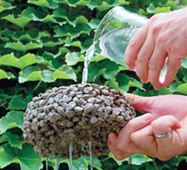
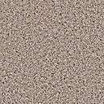

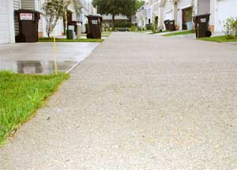
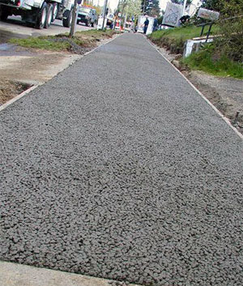
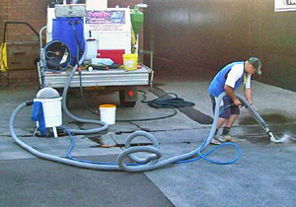

Design Elements- Pervious Pavement
Connected voids in pervious pavement allows water to pass through paved surfaces and soak into a rock base for slow infiltration rather than rapidly enter stormwater sewers via impenetrable pavement used in conventional development.
Pervious pavement requires subbase preparation (leveling and compaction), geotextile fabric, a rock base (to hold water and slowly infiltrate to the subbase), and pervious concrete on top with special preparation methods and slow drying under plastic.
The Barnard Trace LID design uses pervious pavement for a minimally traveled roadway and part of the sidewalk. Use of standard concrete in other areas will save unnecessary expense.
Long-term maintenance is required by routine (quarterly to yearly) vacuum sweeping.
Rain, Snow, Ice
Pervious
Concrete
Gravel/Rock Base
Geotextile Fabric
Pervious
sidewalk
Vacuum
sweeping
Pervious street
Soil Subbase

Slide 19
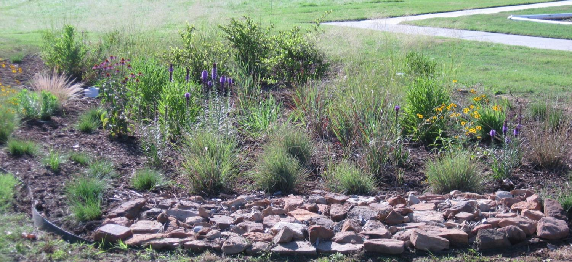
Design Elements- Bioretention
Bioretention cells capture stormwater in a basin up to a foot deep and allow it to soak into the ground. The size and depth of bioretention areas are designed to capture the first flush of stormwater and allow it to drain within 24-48 hours, killing mosquito larvae and pathogens when it dries up.
Bioretention soils and plants help remove pollutants from stormwater
The site soil is Class D with poor drainage, so all biorention areas are designed with 2 feet of storage in an engineered soil mixture of 85-88% sand, 8-12% silt/clay, and 3-5% organics per State of North Carolina specifications.
Three inches of mulch help retain moisture for the plants and retard weed growth.
Bioswales perform in a similar fashion, but have a gentle slope, rather than a basin, to slow down water and allow it to percolate into the ground.

Slide 20
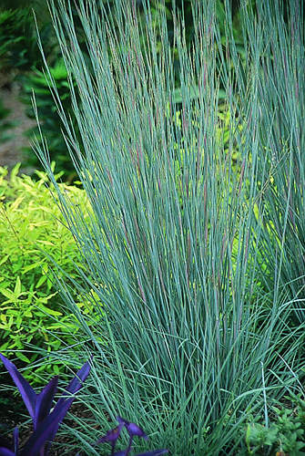
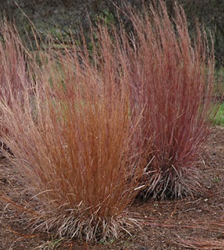
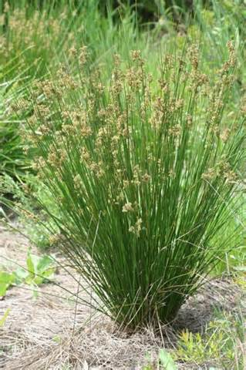
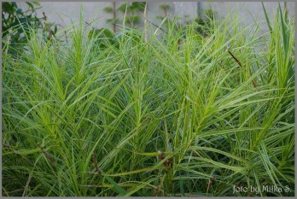
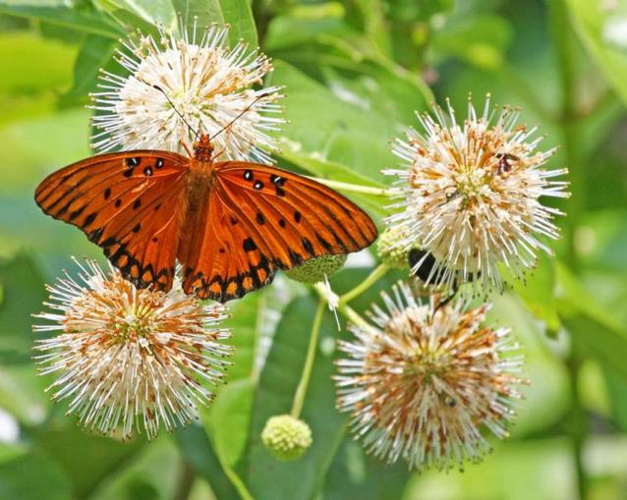
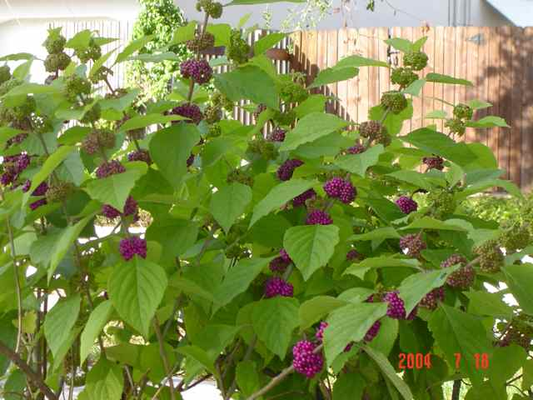
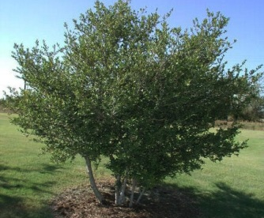
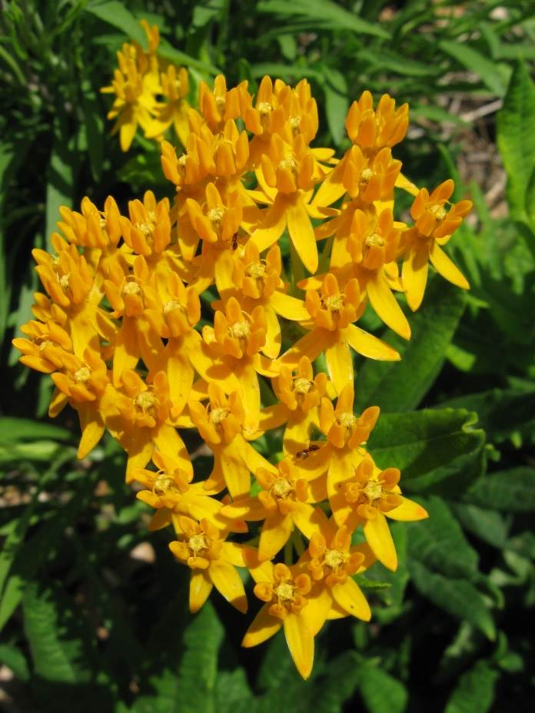
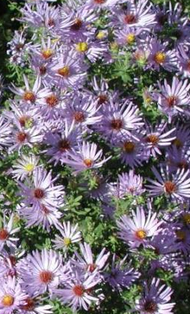
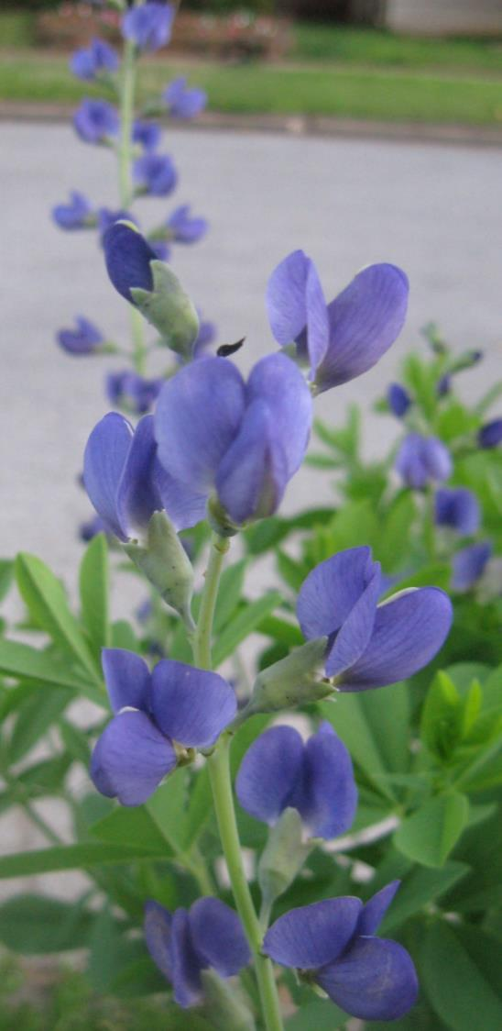
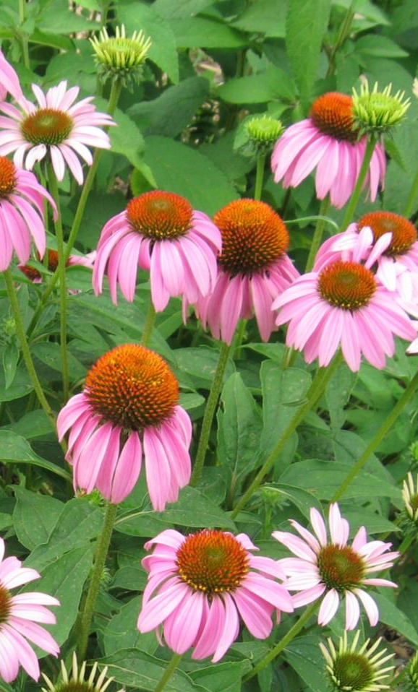
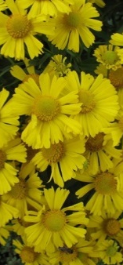
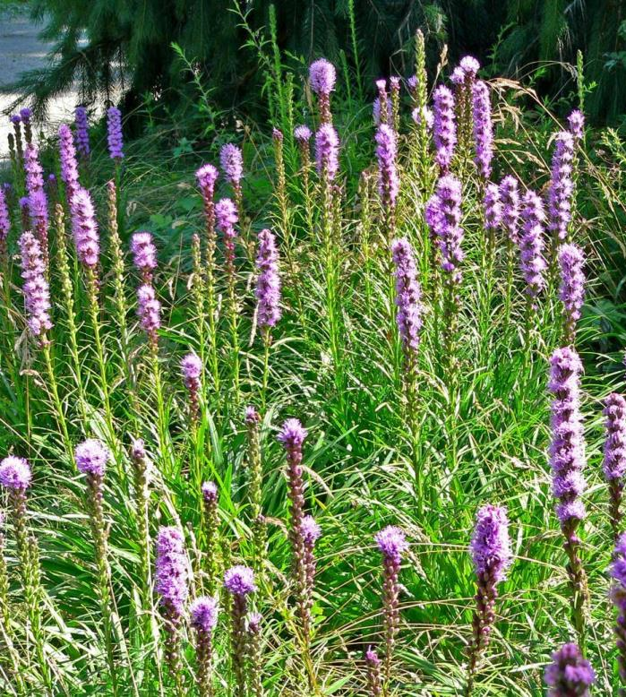
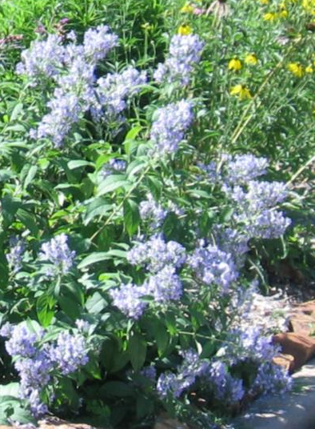
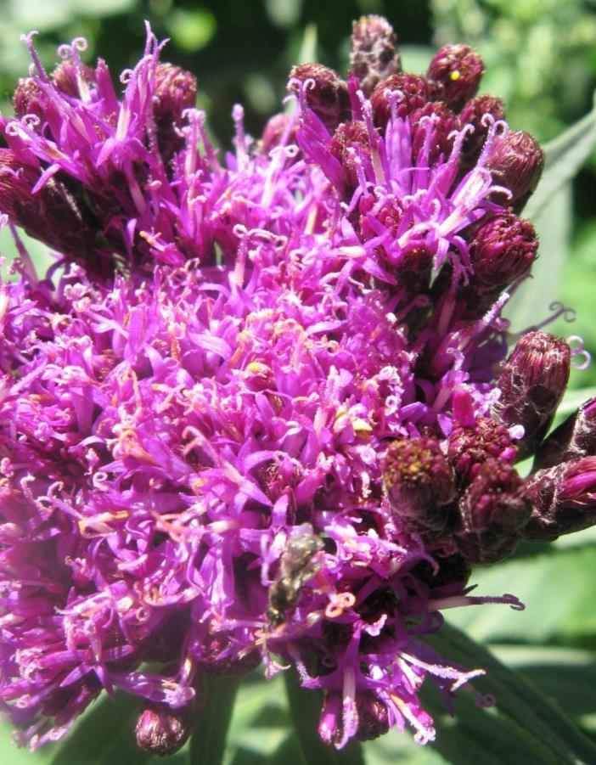
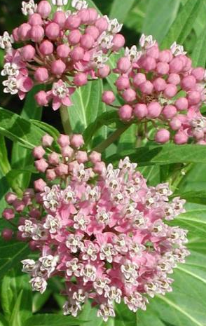
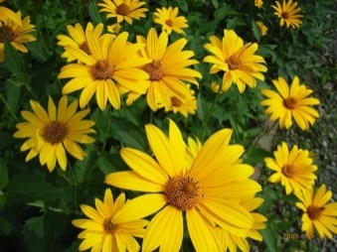
Design Elements- Landscape
Bioretention areas will have a mixture of native grasses shrubs and perennials that are effective at removing pollutants, withstanding periods of wet, and tolerating drought between storms. The use of grasses will prevent erosion and provide winter interest. Flowering perennials will provide seasonal color, and attract native butterflies and other insects. The array of plants are generally low maintenance, requiring, at a minimum, annual harvesting of the previous year’s growth. Weeding is needed until the plants get well established after a couple years.
Sedges, Rushes, and Grasses
1 - Little Blue Stem – Schizachyrium scoporium
2 - Palm Sedge – Carex muskingumensis
3 - Soft Rush – Juncus effusus
Shrubs
4 - Beautyberry – Callicarpa Americana
5 - Buttonbush – Cephalanthus Occidentalis
6 - Yaupon Holly – Ilex vomitoria
Perennials Bloom time
7 - Swamp/Marsh milkweed – Asclepias incarnata June-August
8 - Butterfly milkweed – Asclepias tuberosa May-June
9 - Aromatic Aster – Aster oblongifolius September-August
10 - Wild Blue Indigo – Baptisia australis May-June
11 - Purple coneflower – Echinacea purpurea June-September
12 - Sneezeweed – Helenium autumnale September-October
13 - Ox-Eye Sunflower – Heliopsis helianthoides June-August
14 - Dense Blazingstar – Liatris spicata June
15 - Downy Skullcaps – Scutellaria incana May-July
16 - Ironweed – Vernonia faciculata July-September
1
1
3
2
5
4
6
7
8
9
10
11
12
13
14
15
16

Slide 21
Design Elements- Stormwater Quantity
Increased greenspace, permeable pavers, and bioretention all combine to reduce overall storm flow rates.
Reduced impervious surface area also decreases thermal heating in stormwater.

Slide 22
Design Elements- Stormwater Quality
Runoff from these lots will be filtered through bioretention cells with estimated reductions in phosphorus of 70-85% and total nitrogen removal of 55-65% (Davis et al 2006).
Bacterial/pathogen removal efficiencies of 72-97% can be expected from onsite bioretention (Zhang et al, 2011).
Bioretention is also very effective at removing heavy metal washing off paved areas: Cu 93%, Pb 99%, Zn 99% (Davis et al 2003).

Slide 23
Design Elements- Stormwater Quality
Any water that leaves Barnard Trace during a storm or from irrigation will end up in Crow Creek which is impaired for low dissolved oxygen (DO), pathogens, and poor fish bioassessment (cause unknown). The most likely cause for low DO is nutrient enrichment from highly fertilized lawns in the watershed. Other possible causes of low DO could be warm stormwater running off hot impervious surfaces and solar heating from clearcutting along the stream. In this moderate intensity urban area, pathogens are most likely contributed to some extent from pet waste. Good fish habitat in Crow Creek indicates that poor water quality, possibly from a combination of low DO, pesticides, toxic releases, or other causes, is responsible for poor fish collections.
As previously shown, this design greatly reduces the impact of the development of this site on Crow Creek.
In addition, management considerations can yield further stormwater quality benefits:
With the average lot size 61% of the conventional development, most of the landscaped area will be taken out of homeowner control and managed professionally. Upper middle class homeowners, like the ones expected in this development, tend to over fertilize their lawns.
The vegetation in the common areas will largely be low maintenance and can be managed without excessive fertilizer applications.
Harvesting of the biomass from bioretention areas aids in the long term efficiencies of nutrient removal.
Education can further reduce pollution inputs within the development and the greater community through park visitation:
Signage at the bioretention areas can educate homeowners about the importance of managing nutrients and pet waste.
Pet waste stations with plastic bags and waste receptacles can help encourage pet owners to clean up after their pets, reducing nutrient and pathogen inputs into the creek.
Flyers can be included in realtor sales packages about each pollution source and positive actions homeowners can make to reduce pollution.

Slide 24
Design Elements- Cost
Estimated construction costs comparing this LID design and conventional construction techniques. A savings of over $100,000.

Slide 25
Design- Marketability
The cluster/open space design will increase marketability in a number of ways:
Removing lots along Lewis Avenue from the conventional plan and putting them away from the busy road will recover an average 10% lot value for each of four lots.
  Homes built on busy streets typically sell for 10-20% less than average.
  The second home off busy streets typically sells for 5% less than average.
A new development in Columbus, OH showed 25% increase in lot premiums and accelerated sales for homes built around a village green (Wetli, 2010). The 14 homes on the Barnard village green should receive similar premiums bonuses.
A study in Dallas-Fort Worth showed 20% premiums for lots within 100 feet of a park and 10% premiums at 300 feet (Wetli, 2010). Two lots not directly on the village green are within 100 feet of the park and the remaining two lots are within 300 feet. These 4 lots should show an average 15% premium for proximity to a park.
At the developer’s discretion (and density bonus consideration by the city), 2 additional lots could be located in place of the western bioretention area and the western end of the community garden, while still maintaining significant open space.

Slide 26
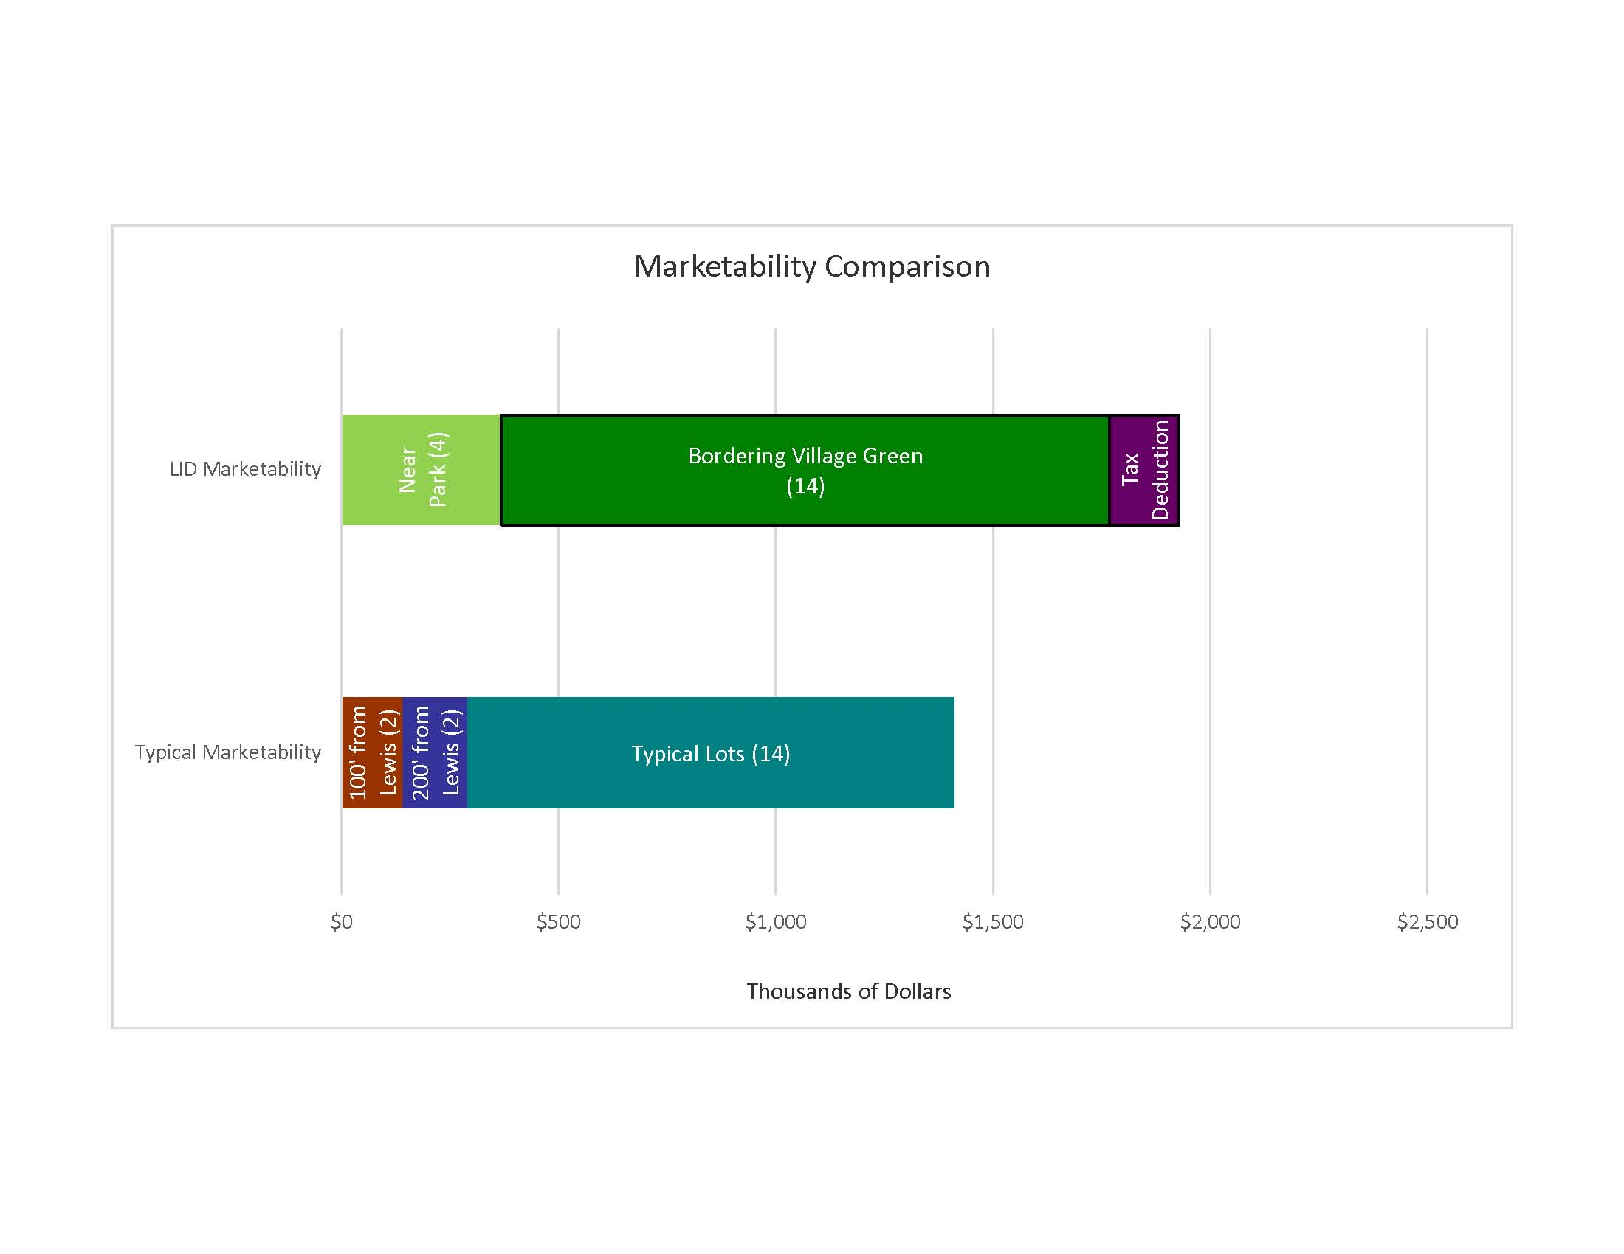
Design Elements- Value
The Barnard Property sold for $1,005,000 and would take about $450,000 to develop conventionally. The developer would have to sell each lot for nearly $80,000 (comparable to a recent sale of a vacant lot in an adjacent neighborhood for $85,000). The developer stands to gain $32,000 by removing lots from a busy street, $280,000 for lots around the village green, $48,000 for homes with proximity to a park, and up to $192,000 for 2 additional lots with proximity to a park. Total marketability benefits would be $360,000 (18 lots) to $552,000 (20 lots). Tax deduction from donation adds $160,000.

Slide 27
Design Elements- Code Challenges
The lot widths and lot areas required for this design are smaller than allowed under the current RS-3 zoning designation. The existing RS-4 codes also require larger lots. However, Tulsa Planning and Zoning are considering adopting a RS-5 code that would allow lots this size (and smaller) to be developed.
Tulsa allows Planned Unit Developments (PUD) to deviate from these conventions to “permit greater flexibility within the development to best utilize the unique physical features of the particular site” and to “provide and preserve meaningful open space”. Zoning and Property Restrictions Ch 11 Sec 1101 For a PUD status to be considered by the zoning board, it would require the site to be developed under a single owner and appropriate plans submitted for public comment
PlaniTulsa’s Utica Midtown Corridor Small Area Plan already supports the inclusion of open space as part of the residential redevelopment of this site.
These techniques saved land area, allowing for the preservation of 1.6 acres (40% of the site) of open space for the community

Slide 28
Design Elements- Code Challenges
Bioretention, pervious pavement, and bioswales, as proposed for this development, are not allowed as an alternative to detention or fee in lieu of detention.
Pervious pavement, proposed as a road surface in this design, is not allowed as a road surface.
Streets width 20 feet with one side of street parking are not allowed. Current street standards are 26 feet wide with parking on both sides. The conventional design used 20 foot alleyways that are consistent with this design.
Front yard minimum is 25 feet in RS-3 zoning. The 15 foot front yards proposed in some homes of this development are common features in the Yorktown Historic District, which has front yards as short as 5 feet. The placement of the homes could be set farther back to accommodate this code, if necessary.
Rear yard minimum is 20 feet in RS-3 zoning. Some detached garages in the proposed development come within 5 feet of the lot line. Garages currently extend all the way to the rear lot line in many Yorktown Historic District homes.
Current regulations require cul-de-sacs to allow fire trucks to turn around on dead end streets. This design uses a variants of a 20’ x 60’ hammerhead, legal in a number of communities across the country, that allows adequate room for fire trucks to turn around by backing up a short distance into one end of the hammer.

Slide 29
Design- Conclusion
The urban redevelopment of the Barnard School Campus requires integrating built, social, and natural environmental factors into a single design. This design respects the existing urban fabric, draws from the site’s rich history, and enhances its ability to treat rainwater that flows into the impaired Crow Creek Drainage Basin.
LID technologies ranging from bioswales to a community garden rain silo were combined with a cluster development to provide a design for the Barnard Site Urban Redevelopment. The open space conserved through reduced lot sizes and street layout provides a meadow for informal gathering that also serves as onsite stormwater remediation. This design reduces stormwater by 30% when compared to its undeveloped state, and also further reduces pollutants by 70-90% when compared with typical development.
Providing open space for the community represents the ideals of LID and provides a link to the site’s history for future residents and users.
This conceptual plan was accomplished while providing over $100,000 dollars (25%) in direct savings for development of the site.
Including marketability, tax deduction, the potential for 2 bonus lots, and reduced construction costs, the developer could net an additional $500,000 to $700,000.

Slide 30
References
Davis, A., Shokouhian, M., Sharma, H., & Minami, C. 2006. “Water Quality Improvement through Bioretention Media: Nitrogen and Phosphorus Removal”, Water Environment Research, 78(3), 284-293.
Davis, A., Shokouhian, M., Sharma, H., Minami, C., & Winogradoff, D. 2003. “Water Quality Improvement through Bioretention: Lead, Copper, and Zinc Removal”, Water Environment Research, 75(1), 73-82.
Wetli, M. (2010, August 19). Leveraging Real Estate Value with Pubilc Open Space. www.development -strategies.com. Retrieved February 10, 2014, from www.development-strategies.com/pdfs_07/review/19August2010.pdf.
Zhang, L., Seagren, E., Davis, A., and Karns, J. 2011. ”Long-Term Sustainability of Escherichia Coli Removal in Conventional Bioretention Media.” J. Environ. Eng., 137(8), 669–677.

